Slide 1
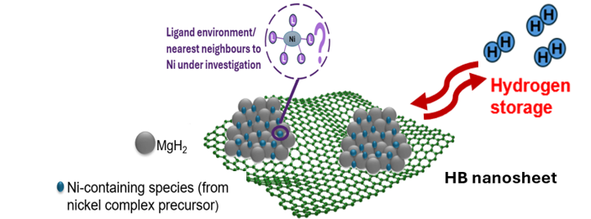
Summary of Research and Future Research Plans
Admission Examination for Master’s Program in Materials Innovation
Design of MgH₂-Ni-2D Nanosheet Composite for Enhancing Hydrogen Release/Storage Property By Nickel Complex Precursor and HB/graphene
Andrea Trevanna
Kondo-Oki Laboratory, Examinee’s number：77CG12001
Notes:
Good day. My name is Andrea Trevanna from the Kondo–Oki Laboratory.
Today, I will present my research plan on the design of MgH₂–Ni–2D nanosheet composites using nickel complex precursors to improve hydrogen release and storage properties.

Slide 2
Content
Introduction
Objective
Research Plan
  Part 1 (B3-M1): Effect of Nickel Complex into Enhancing MgH₂ Hydrogen Release Property
  Part 2( M1): Measuring Hydrogen Storage of the best performing MgH₂-nickel complex composite
  Part 3(M1-M2) Design of MgH₂-Ni-2D Nanosheet for Improved Hydrogen Release/Storage Property and Cyclability
Summary
Notes:
First, I will briefly introduce the background and motivation of my research.

Slide 3
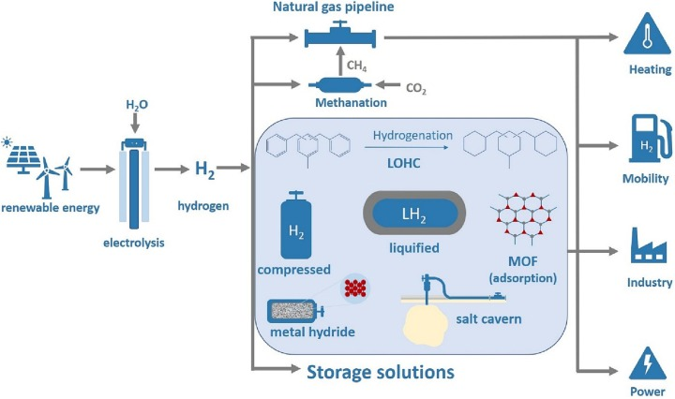
Introduction
Hydrogen as Clean Energy Source
- Carbon-neutral and sustainable
2H₂+O₂=> 2H₂O +electricity
- High gravimetric energy density
- Clean energy
- Can replace fossil fuel
Image from [1]
1] Klopčič et. al, A review on metal hydride materials for hydrogen storage, https://doi.org/10.1016/j.est.2023.108456.
[2] I. Farzat, PBL I-IV Reports, Bachelor’s Thesis, IDE, University of Tsukuba
Efficient and safe hydrogen storage is essential
Notes:
Hydrogen is considered a promising clean-energy carrier because its utilization can produce water without CO₂ emissions. However, efficient and safe hydrogen storage is essential for practical hydrogen-energy systems. I therefore focus on solid-state storage using metal hydrides.

Slide 4
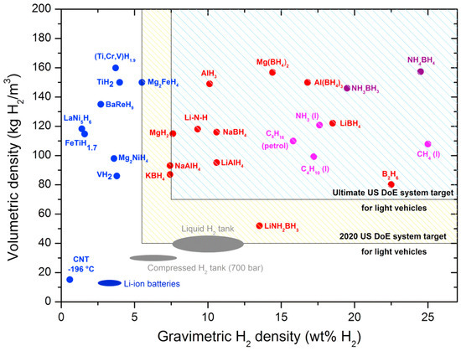
MgH₂: One of the most promising hydrogen storage materials
Introduction
title of this graph
Advantage:
Low cost and Abundant Mg
High hydrogen storage (theoretical 7.6 wt%)
High Volumetric capacity approx. 110 kg m⁻³/0.11kgL⁻¹
High thermodynamic stability
(ΔH ~ 76 kJ/mol)
Challenges and Disadvantage:
Slow H₂ absorption/desorption
High H₂ desorption temperature (>300 °C; target <90 °C)
Too stable Mg–H bonds (ΔE_{des}~160 kJ mol⁻¹)
Poor cycling stability
Development of safer, cost-effective, and lightweight hydrogen storage materials is required​
[1] Yang et.al, Materials 2023, 16(4), 1587
[2] N. Noguchi, Master’s Thesis , 2024, University of Tsukuba
[3] Ahn et. al, Bulletin of the Chemical Society of Japan, Volume 99, Issue 2, February 2026,
[4] K. Tabata, Bachelor’s Thesis, University of Tsukuba
[5] M. Yuan, Master’s Thesis, 2023, University of Tsukuba
Notes:
MgH₂ (animation) is highly promising because magnesium is abundant and inexpensive. It has a theoretical hydrogen capacity of 7.6 weight percent and a volumetric capacity (of approximately 110 kilograms per cubic meter,) above DoE requirements. (animation)
However, its strong Mg–H bonding results in slow hydrogen absorption and desorption, high desorption temperatures above 300 degrees Celsius, and poor cycling stability. (animation)Development of safer, cost-effective, and lightweight hydrogen storage materials is required. ​

Slide 5
Ni as a catalyst
Three main ways for enhancing H₂ release/storage from MgH₂
1) Nanostructuring
2) Catalytic doping such as Ni
3) Addition of 2D material
Advantage of Ni Catalyst
Metallic Ni : Non-Noble-Metal Catalyst with High Activity
  => improved kinetics and lower hydrogen release/absorption temperatures of MgH₂^{[1]}
Challenges
Minimize catalyst loading to preserve H₂ capacity [2]
Smaller, well-dispersed catalyst particles enhance catalytic activity
Solution: Ni catalyst activity can be enhanced by optimised doping and MgH₂/Ni nanostructuring.
[1] Ahn et. al, Bulletin of the Chemical Society of Japan, Volume 99, Issue 2, February 2026, , https://doi.org/10.1093/bulcsj/uoag011
[2] Shen et.al, Journal of Magnesium and Alloys 11 (2023) 3174-3185, Elsevier,
Notes:
Three main ways for enhancing MgH₂^{[1, 2]}：1) Nanostructuring 2) Catalytic doping such as Ni 3) Addition of 2D material. Metallic Ni : high activity, nonnoble and low-cost catalyst to significantly improve the hydrogen storage performance of Mg/MgH₂^{[2]} => improved kinetics and lower hydrogen release/absorption temperatures^{[1]}
₍However, increased Ni loading decreases H2 gravimetric capacity. Thus,) Optimize catalyst doping for better MgH₂ performance to not decrease H2 capacity . Smaller, well-dispersed catalyst particles enhance catalytic activity

Slide 6
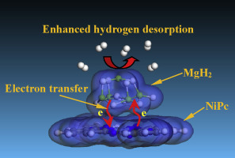
Nickel Complexes as Ni Catalyst Precursor
Multiple additives: synergistic improvement of H₂ kinetics & cycling [1]
[1] Peng et.al, Journal of Alloys and Compounds,
Volume 900, 2022,163547
[2] ] Zhang et. al , International Journal of Hydrogen Energy 42 (2017) 28485-28497
[3] Zhang et. al, https://doi.org/10.1016/j.ijhydene.2017.07.220
Nickel complexes: surrounding atoms/ligands of Ni tune Ni/Mg electronic states and electron transfer [2]
Ni/Mg Electronic states: affect (weakens) Ni-H &Mg–H bonding and Mg–Ni phase formation =>controls H₂ desorption/absorption behaviour [3]
More electron transfer between Nickel phtalocyanine and MgH₂->
Notes:
Multiple additives → synergistic improvement of H₂ desorption kinetics & cycling durability [1] Ni performance depends not only on the amount of Ni, but also on its chemical environment.
Ni complex + MgH₂: Ni-coordinated atoms/ligands may influence Ni/Mg charge states & electron transfer. Ni ^x/y multivalence state gains electrons more easily than Mg2+and acts as electron transfer medium. An example of this in nickel complex is the Excellent catalytic ability of Nickel Phtalocyanine, which has which has enhanced electron transfer in its interaction with MgH2.
( The NiN4 centre in NiPc has electron rich N donating electron to Ni, and the electron rich Ni weakens Mg-H bond)

Slide 7
Nickel Complexes Tunes MgH₂ H₂ release property
Multiple additives: synergistic improvement of H₂ kinetics & cycling [1]
[1] Peng et.al, Journal of Alloys and Compounds,
Volume 900, 2022,163547
[2] ] Zhang et. al , International Journal of Hydrogen Energy 42 (2017) 28485-28497
[3] Zhang et. al, https://doi.org/10.1016/j.ijhydene.2017.07.220
Nickel complexes: surrounding atoms/ligands of Ni tune Ni/Mg electronic states and electron transfer [2]
Ni/Mg Electronic states: affect (weakens) Ni-H &Mg–H bonding and Mg–Ni phase formation =>controls H₂ desorption/absorption behaviour [3]
More electron transfer between Nickel phtalocyanine and MgH₂->
weakened Mg-H bond and decreased dehydrogenation enthalpy of MgH₂
Notes:
When the element bonded to Ni has lower electronegativity, Ni-H bond destabilises, causing easier H2 release from MgH2 . Ni/Mg states determine Ni–H & Mg–H bond stability and catalytic Mg–Ni phase formation →tunes H₂ release/storage behaviour [2] An example is that (from first principles calculation), more electron transfer between Nickel Phtalocyanine and MgH2 weakens Mg-H bond and decreases dehydrogenation enthalpy of MgH2. This suggests that the atoms surrounding Ni may influence hydrogen release through changes in bonding and electron transfer.

Slide 8
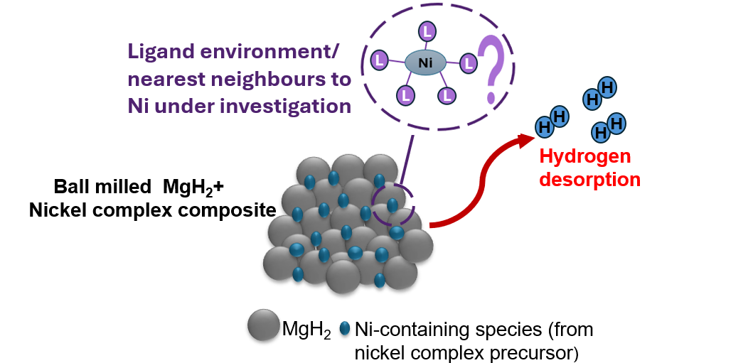
Nickel Complexes Research Gap
Effect of different Ni complex precursors’ chemical environment and their influence on MgH₂ hydrogen release remains unclear.
Different Ni+ MgH₂ preparation methods (Ni loadings, milling conditions,etc), and measurement methods/parameters hinder direct chemical environment influence comparison.
A standardised approach is needed to isolate pure nickel complex chemical environment effects from external preparation and characterisation/ measurement factors (e.g milling conditions, TG/DTA, etc) .
Notes:
However, the influence of nickel complex precursors on MgH2 hydrogen release has not yet been fully clarified. Previous studies use different precursor loadings, milling conditions and measurement conditions, making direct comparison difficult. A standardised approach is needed to isolate pure nickel complex chemical environment effects from external preparation and characterisation/ measurement factors

Slide 9
Objective
1) Lower hydrogen release temperature and activation energy by systematic investigation of each nickel complex doped-MgH₂ composite’s dehydrogenation performance
2) Clarify how the ligand environment of nickel complex precursors affects the hydrogen release and storage properties of MgH₂ : determining charge state of Ni/Mg and electron transfer pathway
Notes:
Therefore, my central question is: how does the chemical environment of a Nickel complex precursor affect the resulting Ni species, Ni/Mg electronic state, MgH₂–Ni interface, and hydrogen-release behaviour?
My objective is to systematically improve the hydrogen release property and (animation) compare different nickel complex precursors under identical conditions and clarify their influence on hydrogen release and storage.

Slide 10
Research Plan
Part 1 (B3-M1): Effect of Nickel Complex into Enhancing MgH₂ Hydrogen Release Property
Part 2( M1): Measuring Hydrogen Storage of the best performing MgH2-nickel complex composite
Part 3(M1-M2) Design of MgH₂-Ni-2D Nanosheet for Improved Hydrogen Release/Storage Property and Cyclability
Notes:
This is my overall research plan, which consists of three parts. The part I am now researching on is the first part, addition of nickel complex on the thermal hydrogen release property of MgH2

Slide 11
Current Research: Step 1. Optimisation of Ball milling Conditions with MgH₂-Ni(acac)₂ composite
To produce a reproducible ball milling method for future MgH₂+Nickel complexes
1
Investigate two ball milling methods to see if it is better to preserve the original structure of nickel complex dopant (using gentle ball milling conditions) or completely change the structure (intensive/harsher conditions)
2
Ni(acac)₂ addition has lower hydrogen release temperature 260°C=>234 °C(1 wt.%->10wt.%) than ball milled MgH₂ (265°C) and releases 7.26->6.66 wt% (1 wt%.->10 wt.%)
Shen et.al 2023 Journal of Magnesium and Alloys 11 (2023) 3174-3185, Elsevier
We start with Nickel acetylacetonate (Ni(acac)₂) due to its high reported performance on improvement of MgH₂ hydrogen release-storage property
3
Notes:
Before comparing different nickel complexes, I first optimized the ball-milling conditions using Ni(acac)₂. We want to see if it is better to preserve the original structure of the nickel complex dopant using gentle, low speed ball milling or if it is better to completely break and change the structure. I selected Ni(acac)₂ as the model precursor because previous research reported good performance and over 7 wt.% H2 release. However, Increasing its loading lowered the release temperature, but also reduced hydrogen capacity.
(I selected Ni(acac)₂ as the initial model precursor because previous research reported high hydrogen-release performance.
Increasing Ni(acac)₂ loading from 1 to 10 weight percent decreased the hydrogen-release temperature, but also decreased hydrogen capacity.
This indicates a trade-off between catalytic activity and hydrogen capacity.
Therefore, I selected a low loading of 2 weight percent for my precursor comparison.)
(I use Ni(acac)2 due to its exceptionally high reported hydrogen release and storage properties. On its first cycle, it can releases 7.26 wt% to 6.66 wt% (decreasing H2 capacity if using higher Ni(acac)2 loading). If combined with extended graphite, MgH2-Ni(acac)2-EG composite can retain 7.03 wt%, over 7 wt.% after 10 cycles, which Shen et.al believe is the highest performance of any MgH2 composite. (This will be elaborated later in Part 3 of my research plan).
I compare two ball milling methods: intensive vs gentle method. I want to see if it is better to preserve the original nickel complex structure (using gentle conditions) or completely destroy/change the structure (using intensive conditions)
(intensive method and gentle method to preserve structure of + Ni(acac)₂ )

Slide 12
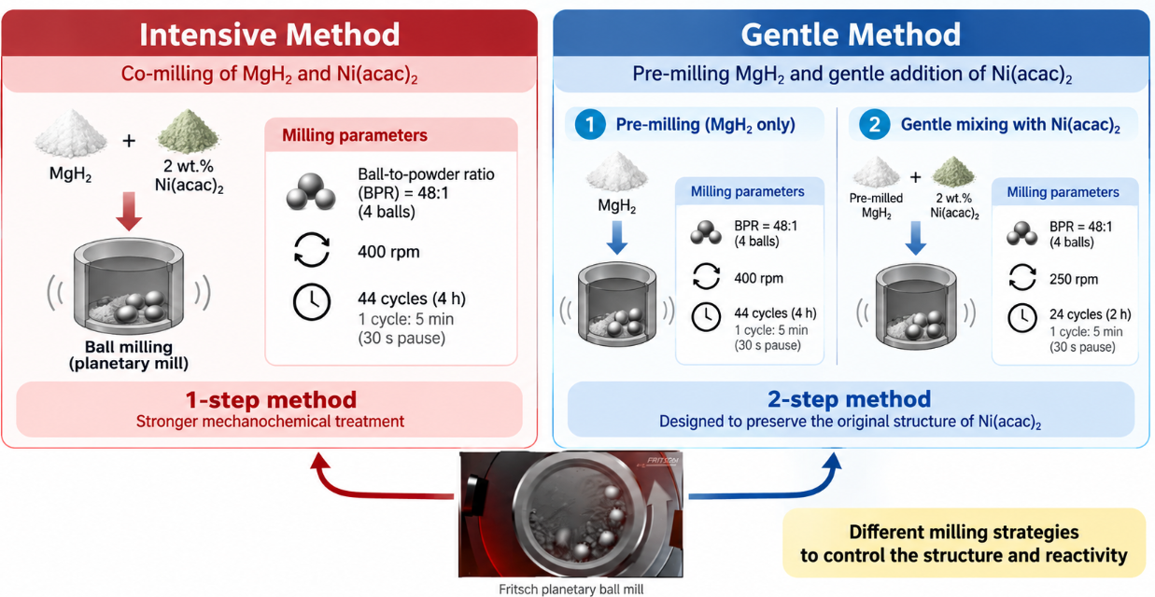
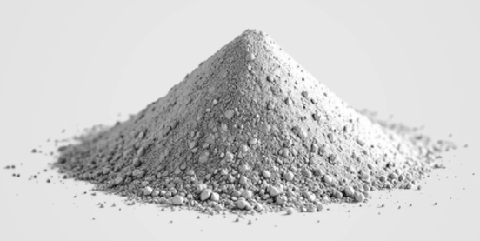
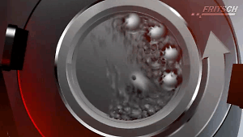
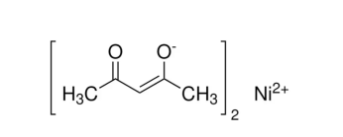
2 Ball Milling Methods
Ni(acac)₂
Fritsch planetary ball mill
Both methods in Ar atmosphere
Notes:
Therefore, I selected 2 weight percent Ni(acac)2 as a low catalyst loading for systematic comparison. I compared two milling methods. The intensive method co-mills MgH₂ and Ni(acac)₂ at 400 rpm for four hours. The gentle method first mills MgH₂ and then mixes Ni(acac)₂ under milder conditions, with the aim of preserving more of its original structure.
(I compared two milling methods.
In the intensive method, MgH₂ and Ni(acac)₂ were co-milled for four hours at 400 rpm.
In the gentle method, MgH₂ was first milled, and Ni(acac)₂ was then added under gentler conditions.
The purpose was to investigate whether preserving the original precursor structure or more strongly transforming it gives better hydrogen-release performance)
(Intensive method is 1 step co-milling of MgH2 and Ni(acac)2 using harsher and longer parameters.(4 hours and 400 rpm)
Whereas, gentle method is 2 step process. First, I ball milled Mgh2 using the same conditions as the previous method. Second, Ni(acac)2 is ball milled gently with MgH2 => less time (2 hours) and slower speed, designed to preserve the original Ni(acac)2 structure)

Slide 13
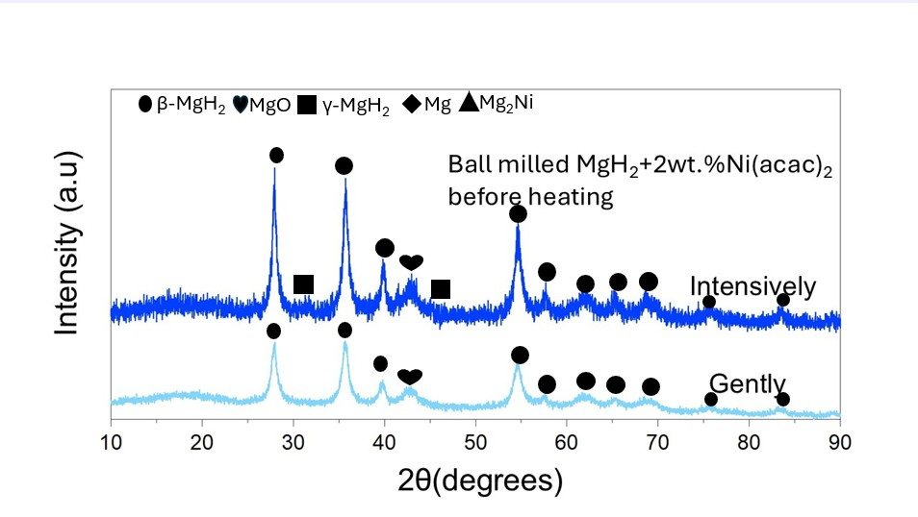
XRD Result: After ball milling
Both After milling: No crystalline Ni(acac)₂/Ni
→possible decomposition / reaction /
Ni high dispersion ^{[1]}
Before dehydrogenation: β-MgH₂ and MgO; γ-MgH₂ phase (which usually exists at high pressure^{[2]}) only after intensive milling
Possible reaction during ball milling:
MgH₂ + Ni(acac)₂ → MgO formation [1]
[1] Shen et.al, Journal of Magnesium and Alloys 11 (2023) 3174-3185, Elsevier,
[2] Shang et.al, Materials Transactions, Vol. 44, No. 11 (2003) pp. 2356 to 2362
Notes:
After milling, no crystalline Ni(acac)₂ or Ni peaks were detected.
This may indicate precursor decomposition, reaction with MgH₂, or highly dispersed Ni-containing species. Before dehydrogenation, both samples mainly contained MgH₂, while the intensively milled sample also showed metastable gamma-MgH₂. which usually exists at high pressure) MgO may be due to reaction between MgH2 and Ni(acac)2 during ball milling
(After milling, no crystalline Ni(acac)2 or Ni peaks detected. This might be due to dispersion below the detection limit, decomposition, or reaction with MgH2. Before heating, b-MgH2 and MgO observed in both, but y-MgH2 as detected only in the internsive. The formation of MgO phase possibly is a result of reaction between Ni(acac)2 and MgH2 during ball milling. After heating, Mg and O are dominant)

Slide 14
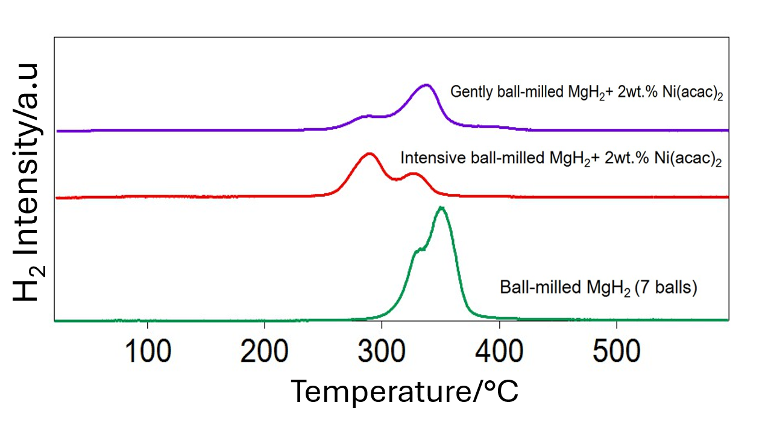
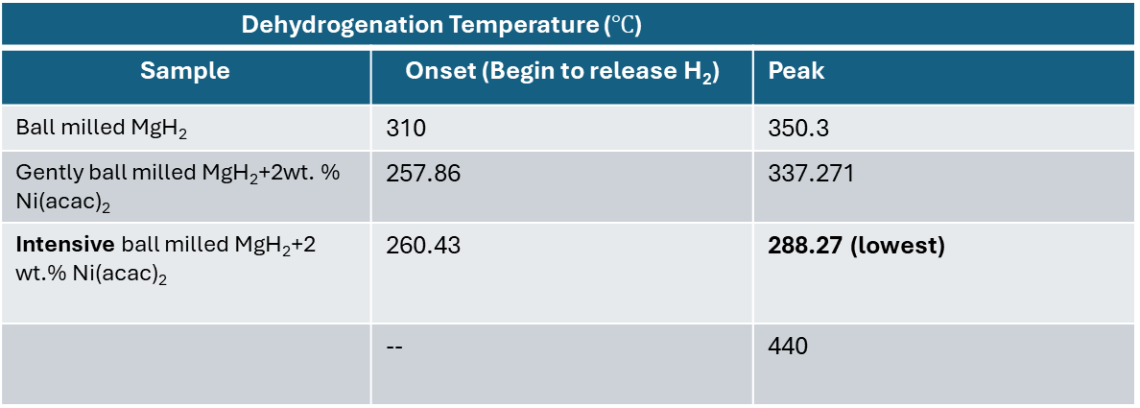
Result: Hydrogen release Property
m/z=2
Only 2 wt.% Ni(acac)₂ → lower H₂-release temperature compared to ball milled and esp. commercial MgH₂
Broader desorption peaks → compared with sharper MgH₂ peak
Low temp population is large in intensive
Dehydrogenation Temperature ($℃$)
Sample | Onset (Begin to release H₂) | Peak
Ball milled MgH₂ | 310 | 350.3
Gently ball milled MgH₂+2wt. % Ni(acac)₂ | 257.86 | 337.271
Intensive ball milled MgH₂+2 wt.% Ni(acac)₂ | 260.43 | 288.27 (lowest)
 | -- | 440
Intensive ball-milling method is better and shows most favourable H₂-release behaviour
As received MgH₂
(Campostrini et.al, J Therm Anal Calorimetry
--
modify
Notes:
The key result is that both Ni(acac)₂-containing samples released hydrogen at lower temperatures than ball-milled and commercial MgH₂. The main peak was approximately 337 degrees for the gentle sample, but only 288 degrees Celsius for the intensive sample. Therefore, intensive milling gave the most favourable hydrogen-release behaviour.
(The hydrogen-release measurements showed that both Ni(acac)₂-containing samples released hydrogen at lower temperatures than ball-milled MgH₂, and much lower than commercial MgH2
(The onset was approximately 258 degrees for the gentle sample and 260 degrees for the intensive sample.)
More importantly, the intensive sample showed its main peak at approximately 288 degrees, compared with 337 degrees for the gentle sample. )

Slide 15
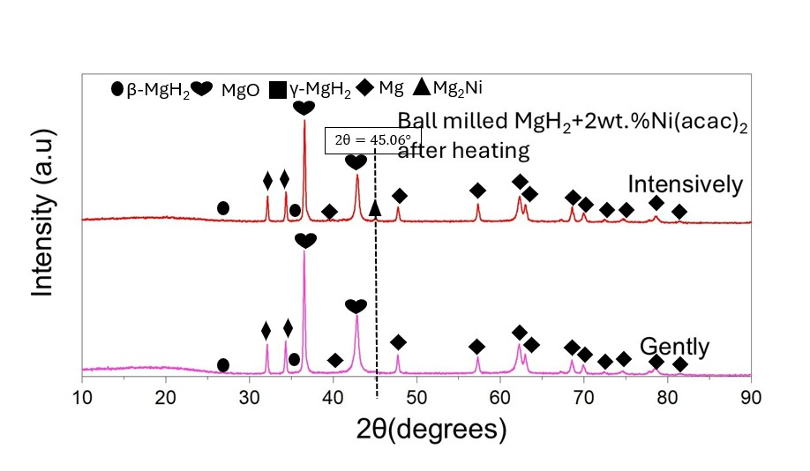
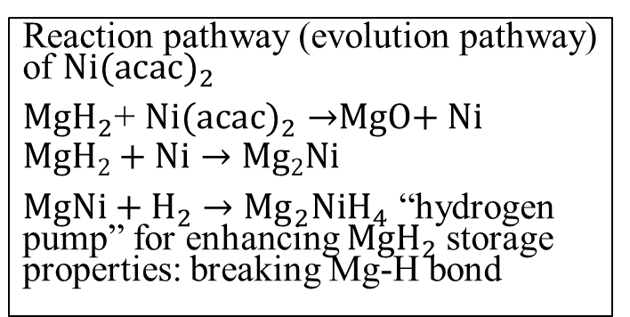
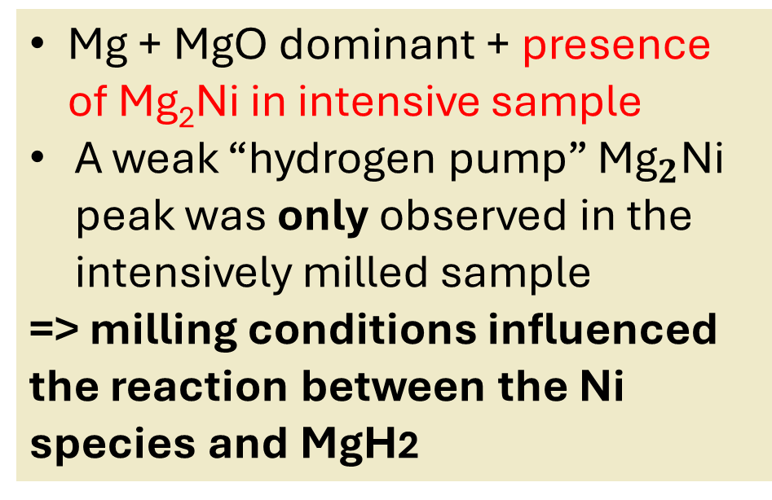
XRD Result After Heating/Hydrogen Release: Mg₂Ni
Mg + MgO dominant + presence of Mg₂Ni in intensive sample
A weak “hydrogen pump” ${\text{Mg}}_{2}\text{Ni}$ peak was only observed in the intensively milled sample
=> milling conditions influenced the reaction between the Ni species and MgH2
Mg₂Ni catalyst : promotes H₂ desorption by destabilizing Mg–H bonds and facilitating H dissociation.
Liu et.al, Int.J.Hydrogen Energy 41 (2016) 10718-10974
Reaction pathway (evolution pathway) of ${Ni(acac)}_{2}$
${MgH}_{2}$+ ${Ni(acac)}_{2}→$MgO+ Ni
$$MgH2+Ni→Mg2Ni$$
$MgNi+H_{2}$ $→{Mg}_{2}{NiH}_{4}$ “hydrogen pump” for enhancing ${MgH}_{2}$storage properties: breaking Mg-H bond
Shen et.al, Journal of Magnesium and Alloys 11 (2023) 3174-3185, Elsevier, https://doi.org/10.1016/j.jma.2021.12.003
Notes:
After hydrogen release, both samples contain Mg and MgO. Mg₂Ni, a catalytic phase, appeared at only the intensive milled sample. Mg₂Ni may promote hydrogen transfer through a hydrogen-pump effect. MgO and Mg2Ni may be products of reaction of MgH2 and Ni(acac)2. (However, this is currently a possible contribution rather than a proven mechanism. )
(After hydrogen release, a weak peak around 45.06 degrees was observed only in the intensively milled sample and was assigned to Mg₂Ni.
Catalytic Mg₂Ni has been proposed to promote hydrogen transfer through a so-called hydrogen-pump effect.
Therefore, the difference between the two milling methods may be related to differences in Ni–Mg reaction and Mg₂Ni formation.
However, I consider this a possible explanation rather than a proven mechanism at this stage. )
(An interesting/notable result is the presence of Mg2Ni. (Animation)
The gently ball milled sample may have no Mg2Ni due to the small content of the Ni phase or the small size in situ formed Ni particles from Ni(acac)2, which might result in the corresponding diffraction peaks being too weak to detect.
With no Mg₂Ni detected in the dehydrogenated gently ball milled sample, the sample may lack the Mg2Ni “hydrogen pump” which helps promoting better hydrogen desorption performance)

Slide 16
Conclusion and Future Plan
Intensive ball milling method is chosen the standard ball milling method for future nickel complexes
Initial temperature alone cannot assess catalyst performance.
Further analysis of phase formation, Ni dispersion, MgH₂–Ni interfaces, and structural evolution by IR and SEM/TEM is required before reliably comparing Ni complex precursors.
Notes:
Due to the intensive ball milling method shows lowest and thus most favorable hydrogen release behaviour, I will use intensive ball milling method as the standard ball milling method for future nickel complexes.
However, initial temperature alone is insufficient to evaluate catalyst performance
Further clarify: phase formation, Ni dispersion (by SEM and TEM), MgH₂–Ni interfaces, multistep release & structural evolution (IR)
These points must be resolved before different nickel complex precursors can be compared reliably

Slide 17
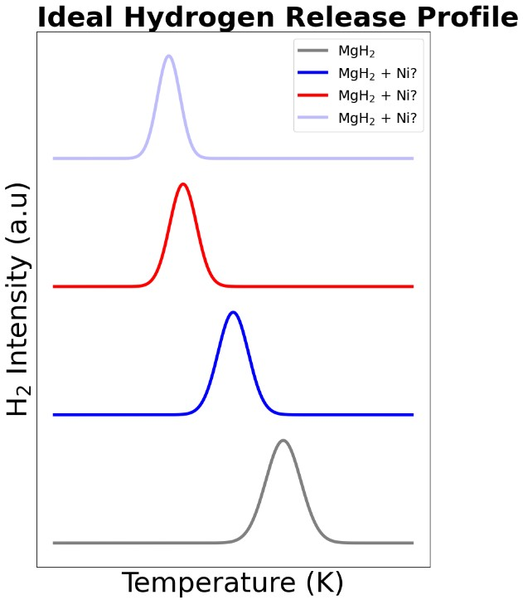
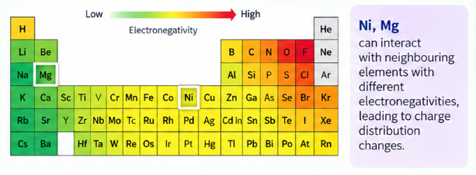
H₂ release from Mg + Different Nickel complexes
Goal:
Improve H₂ release (dehydrogenation) kinetics of MgH₂
Ni- Ligand (L): Ligand Table
❓
❓
Decreased temperature of hydrogen release and activation energy
❓
TG-DTA-TPD for hydrogen release measurement
IR and XPS to determine reaction mechanism and interaction of Ni and Mg with neighbouring elements/ligands
Which nickel complex when doped into MgH₂ will lead to most hydrogen release temperature decrease and improved kinetics?
Notes:
Based on these findings, I will identify the Nickel complex precursor that gives the lowest H₂-release temperature. (animation) I will compare Ni complexes based on the electronegativity of the element bonded to Ni. elements with low electronegativity destabilise Ni-H bond, which makes hydrogen release easier. C, N, and O will be compared, while Cl-containing complexes will be included to investigate its reported kinetic-inhibiting effect and the underlying reaction pathways.
Based on these findings, the next goal is to determine which nickel complex precursor provides the most favourable hydrogen-release kinetics-> lowest hydrogen release temperature. I will choose nickel complex precursors based on the electronegativity of the nearest element bonding with Ni. It is reported that elements with low electronegativity destabilise Ni-H bond, which makes hydrogen release easier. I will choose nickel complexes with neighbouring elements to Ni such as C, N, and O. However, Cl has a kinetic inhibiting effect, so I want to compare nickel complexes containing Cl to clarify the reaction pathways and rate-controlling factors.

Slide 18
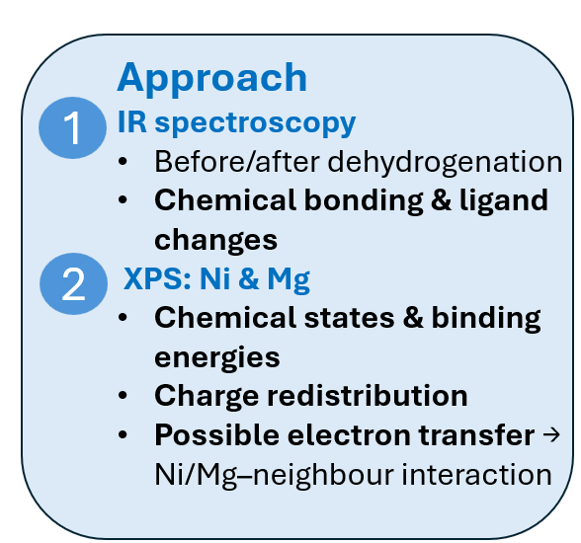
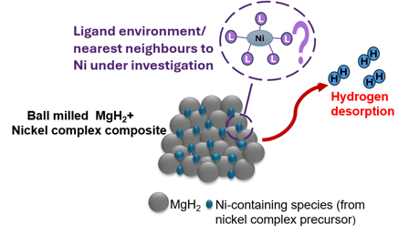

Elucidate the Hydrogen Release Mechanism and Ligand Influence/Interaction
Correlate Ni/Mg charge states → Ni ligand–MgH₂ interaction and electron transfer→ H₂ release
Notes:
(Skip this part if I do not have time)
I will use XRD, IR, XPS , TEM/SEM-EDX to determine the difference in hydrogen release performance originates from nickel complex ligand decomposition, Ni/Mg chemical state +electron transfer, or from Ni dispersion. With XPS, I can correlate Ni/Mg charge state with Ni ligand-MgH2 interaction and electron transfer. I will then investigate the catalytic reaction mechanism.(I will use XRD, IR, XPS, TEM and SEM-EDX to determine whether the difference in hydrogen release performance originates from precursor decomposition, Ni chemical state, Ni dispersion, or interfacial structure. I will then investigate the catalytic reaction mechanism. (In particular, XPS will provide Ni and Mg chemical-state information through binding-energy shifts, allowing me to evaluate changes in charge distribution and interfacial interactions))

Slide 19
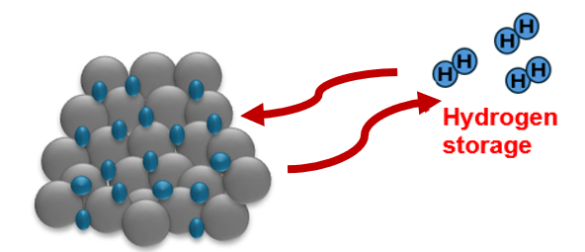
Research Plan
Part 1 (B3-M1): Effect of Nickel Complex into Enhancing MgH₂ Hydrogen Release Property
Part 2( M1): Measuring Hydrogen Storage of the best performing MgH₂-nickel complex composite
Part 3(M1-M2) Design of MgH₂-Ni-2D Nanosheet for Improved Hydrogen Release/Storage Property and Cyclability
Notes:
After identifying the most promising precursor for hydrogen release, I will proceed to hydrogen-storage measurements.

Slide 20
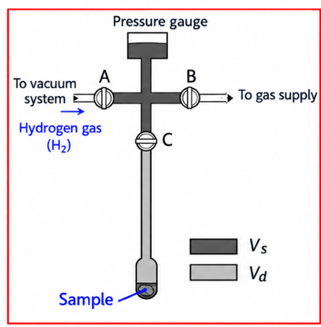
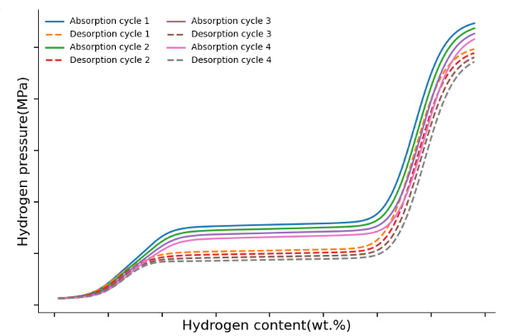
Part 2: PCT for Hydrogen Storage
Pressure-Composition-Temperature experiments will be conducted on the best performing MgH₂+nickel complex composite to measure hydrogen uptake / hydrogen storage
Repeated hydrogen absorption/desorption cycle to measure cyclability(how much hydrogen will be retained afterwards)
Notes:
PCT measurements on the best performing composite will determine reversible hydrogen capacity and absorption and desorption behaviour(, equilibrium pressure, and thermodynamic properties.) Repeated hydrogenation and dehydrogenation will then evaluate cycling stability.
(The best-performing MgH₂–Ni composite will be evaluated using pressure–composition–temperature measurements.)
I will determine its hydrogen-storage capacity, absorption and desorption behaviour, and reversibility.
Repeated hydrogenation and dehydrogenation will then be used to evaluate cycling stability.

Slide 21
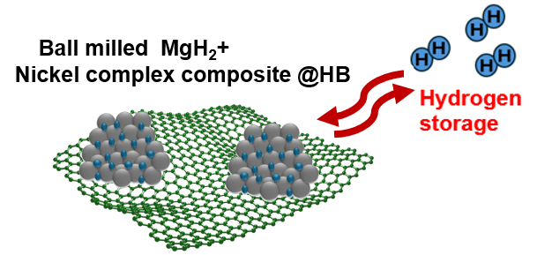
Research Plan
Part 1 (B3-M1): Effect of Nickel Complex into Enhancing MgH₂ Hydrogen Release Property
Part 2( M1): Measuring Hydrogen Storage of the best performing MgH2-nickel complex composite
Part 3(M1-M2) Design of MgH₂-Ni-2D Nanosheet for Improved Hydrogen Release/Storage Property and Cyclability
Notes:
The final stage is to improve the stability of the optimized MgH₂–Ni composite using a two-dimensional support.

Slide 22
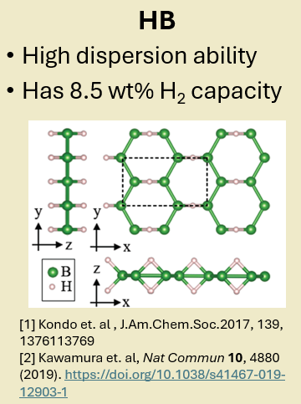
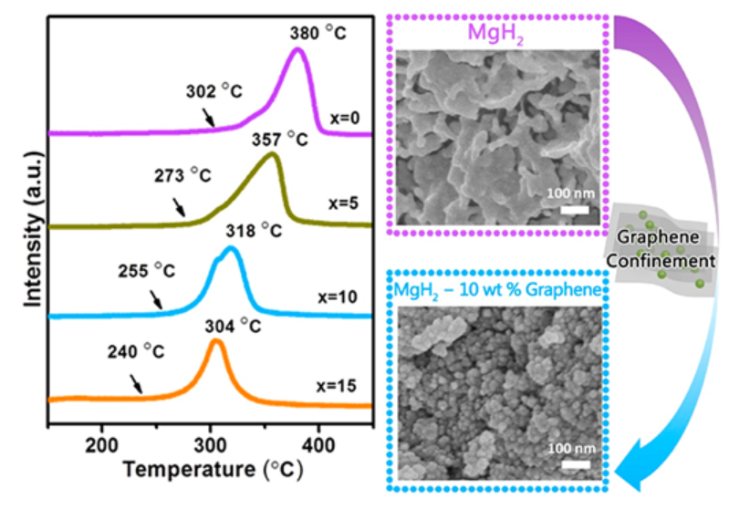
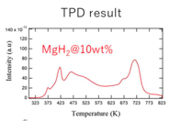
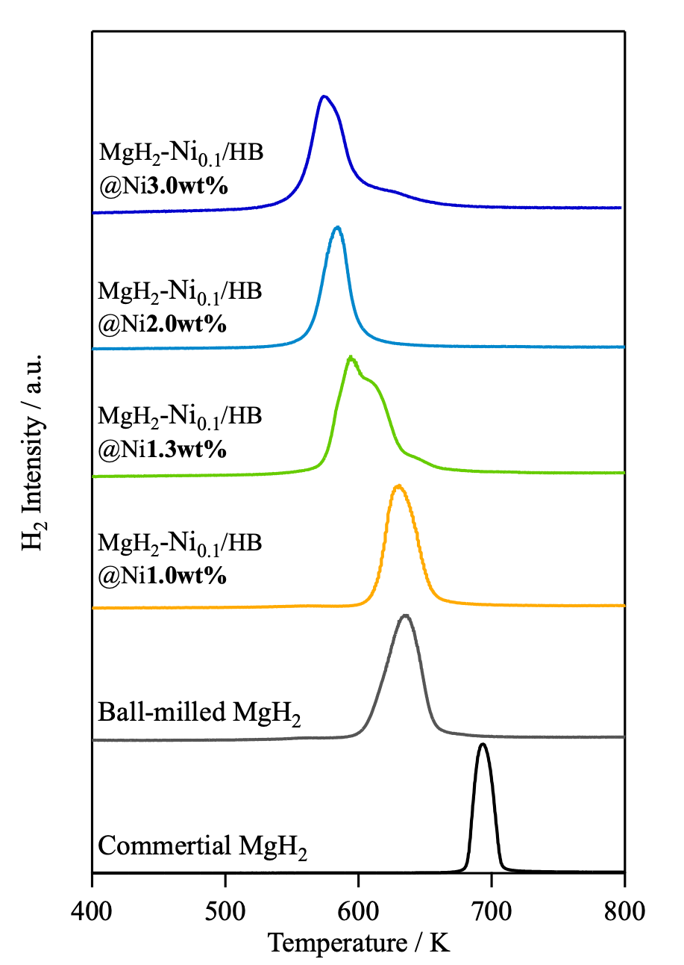
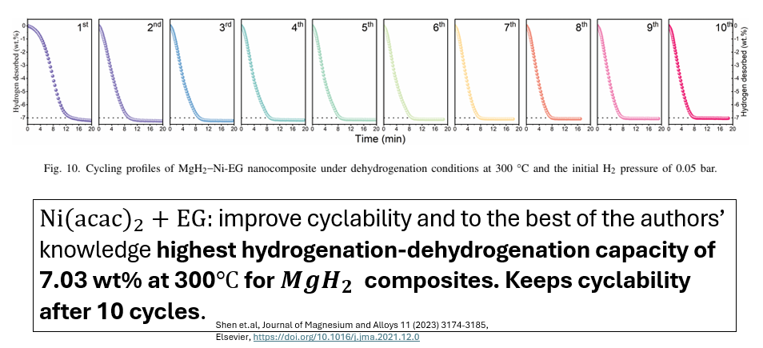
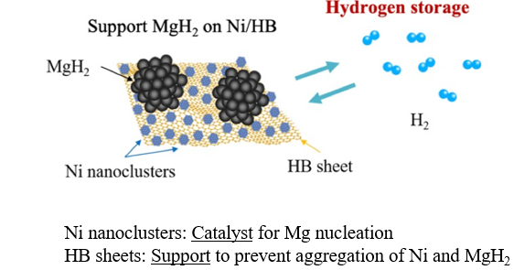
Supporting MgH₂ on 2D materials with Ni Catalyst
1. MgH₂+Graphene
2. MgH₂ @HB
2D nanosheets suppress grain aggregation and aid in dispersion of nanoparticles → improve cycling stability
K. Goto, Master’s Thesis, 2023
N. Noguchi, Master’s Thesis, 2024
Q. Zhang et. al, ACS Appl. Nano Mater. 28 June 2019; 2 (6): 3828–3835.
3. MgH₂+Ni(acac)₂+Extended Graphite
4. MgH₂+Ni/HB
N. Noguchi, Master’s Thesis, 2024
Notes:
(Just glaze over this quickly, I don’t have time just say 2D nanosheets improve cycling stability. Graphene-based nanosheets is a promising support due to its high surface area and nanoconfinement effect. HB, developed in our laboratory, is also promising because of its ultrathin structure, high dispersibility, and high hydrogen capacity.
Two-dimensional materials can suppress particle aggregation and maintain nanoparticle dispersion. Graphene is a promising support because of its high surface area and nano confinement effect.. HB is another promising support developed in my laboratory. It has an ultrathin structure, high dispersion ability, and a theoretical hydrogen capacity of 8.5 weight percent. Previous work reported that Ni(acac)₂ + EG showed the highest MgH₂ composite cyclability, maintaining over 7 wt% H₂ after 10 cycles.
Two-dimensional materials can suppress grain aggregation and maintain nanoparticle dispersion during cycling. They can therefore help preserve active interfaces while improving hydrogen diffusion and cycling stability. This is complementary to the catalytic role of Ni.
(Metal hydrides provide high hydrogen capacity but have strong hydrogen bonding and slow kinetics.
In contrast carbon-based materials can provide interfaces and structural confinement.
Therefore, combining them may balance hydrogen capacity with improved kinetics and stability.)
Graphene is one candidate because its high surface area and confinement effects can improve MgH₂ dispersion. Previous work reported approximately 3-nanometer MgH₂ nanoparticles supported by graphene, with a desorption peak of 318 degrees Celsius, 62 degrees lower than pure MgH₂.
Hydrogen boride, or HB, is another promising support developed in our laboratory.
HB has high dispersion ability and a theoretical hydrogen capacity of 8.5 weight percent.
It can also support highly dispersed Ni nanoclusters.
If combined with extended graphite, MgH2-Ni(acac)2-EG composite can retain 7.03 wt%, over 7 wt.% after 10 cycles, which Shen et.al believe is the highest performance of any MgH2 composite.
(-2D nanosheets/materials inhibit grain aggregation and improve cyclability
-The addition of carbon can be used as a grinding aid to inhibit the grain aggregation and growth of Mg/MH2 during cycle life(kinetics)
Large surface area and high porosity of carbon allotropes offer improved adsorption sites, enhancing their gas storage capabilities
-1st example: On the basis of high surface area and active sites, graphene is chosen as support material to in situ grow MgH₂ nano-particles
The well-dispersed MgH₂nanoparticles (∼3 nm) and the confinement effect of graphene result in the improved hydrogen storage properties
The peak hydrogen desorption temperature of MgH₂ nano-particle−10 wt % graphene nanosheet composites is 318 °C, which is 62 °C lower than the pure MgH ₂₎

Slide 23
Part 3: Addition of 2D Nanosheet to MgH₂-Ni composite
Select and synthesise a promising 2D nanosheet (e.g., graphene ,HB, or Ni/HB)
Combine it with the best-performing MgH₂–Ni complex by
Ball-mill at a 1:1 Ni complex/2D nanosheet ratio for balancing
(MgH₂: 2 wt.% NiX: 2 wt.% 2D nanosheet or MgH₂: 1 wt.% NiX: 1 wt.% Nanosheet)
Purpose: Enhance H₂ sorption kinetics & cycling stability
Suppress Mg/MgH₂ particle growth & maintain Ni dispersion
Preserve active Mg–Ni interfaces → improve H₂ diffusion
Notes:
2D nanosheets such as graphene and extended graphite is reported to enhance kinetics and cycling stability., I will add a promising 2D nanosheet such as HB or graphene to the optimized MgH₂–Ni composite to enhance kinetics and improve H2 cycling stability( suppress particle growth, maintain Ni dispersion, preserve active Mg–Ni interfaces, and improve cycling stability. )
(Therefore, I will introduce promising 2D nanosheet such as HB, graphene or extended graphite into the best-performing MgH₂–Ni composite.
The expected effects are suppression of Mg/MgH₂ particle growth, maintenance of Ni dispersion, preservation of Mg–Ni interfaces, and improved hydrogen diffusion and cycling stability. )

Slide 24
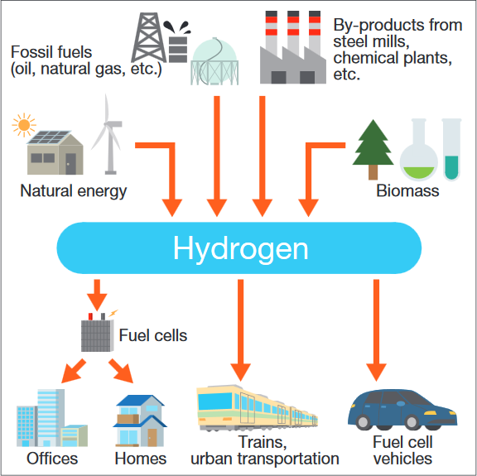
Summary
https://www.japan.go.jp/tomodachi/2017/spring-summer2017/creating_a_hydrogen_society.html
This research aims to boost hydrogen release of MgH₂, a highly promising hydrogen storage material, by doping several nickel complexes as Ni catalyst precursor
Ni complex doping → clarify chemical-environment effects on MgH₂ H₂ release
Best MgH₂–NiX composite → evaluate H₂ storage & cycling by PCT
Add 2D nanosheets (graphene/HB )→ further improve storage performance & cycling stability
This will path a comprehensive nano catalyst design guideline into efficient hydrogen release/storage of MgH₂ and help form a cleaner, more sustainable future with hydrogen energy source => hydrogen society
Notes:
(Only read this if I have time)
In summary, my research aims to establish a relationship between Nickel complex precursor chemistry /chemical state and hydrogen-storage performance.
First, I will systematically compare nickel complex precursors for hydrogen release.
Second, I will evaluate the best composite for hydrogen storage and cycling.
Finally, I will introduce HB or graphene to further improve stability.
Ultimately, I aim to develop a comprehensive design strategy for efficient MgH₂-based hydrogen-storage materials.
(In summary, my research aims to establish a relationship between nickel precursor chemistry, the resulting Ni chemical environment and interface, and the hydrogen-storage performance of MgH₂.
First, I will systematically compare nickel complex precursors for hydrogen release.
Second, I will evaluate the best composite for hydrogen storage and cycling.
Finally, I will introduce HB or graphene to further improve stability and performance.
Through this approach, I aim to develop a comprehensive design strategy for efficient MgH₂-based hydrogen-storage materials.)

Slide 25
Thank you very much!
Notes:
(Not necessary slide)

Slide 26
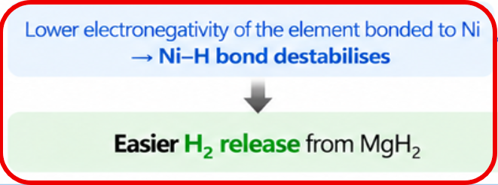
Nickel Complexes as Ni Catalyst Precursor
Multiple additives: synergistic improvement of H₂ kinetics & cycling [1]
Nickel complexes: surrounding atoms/ligands of Ni tune Ni/Mg electronic states and electron transfer [2]
Ni/Mg Electronic states: affect (weakens) Ni-H &Mg–H bonding and Mg–Ni phase formation =>controls H₂ desorption/absorption behaviour [3]
[2]
More electron transfer between Nickel phtalocyanine and MgH₂-> weakened Mg-H bond and decreased dehydrogenation enthalpy of MgH₂
[1] Peng et.al, Journal of Alloys and Compounds,
Volume 900, 2022,163547
[2] ] Zhang et. al , International Journal of Hydrogen Energy 42 (2017) 28485-28497
[3] Zhang et. al, https://doi.org/10.1016/j.ijhydene.2017.07.220
Notes:
Multiple additives → synergistic improvement of H₂ desorption kinetics & cycling durability [1]
Ni complex + MgH₂: Ni-coordinated atoms/ligands may influence Ni/Mg charge states & electron transfer. Ni performance depends not only on the amount of Ni, but also on its chemical environment. (In a study of nickel compounds) , When the element bonded to Ni has lower negativity, NiH bond destabilises, causing easier H2 release from MgH2 . Ni/Mg states determine Ni–H & Mg–H bond stability and catalytic Mg–Ni phase formation →tunes H₂ release/storage behaviour [2] This suggests that the atoms surrounding Ni may influence hydrogen release through changes in bonding and electron transfer.

Slide 27
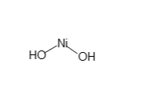
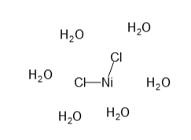
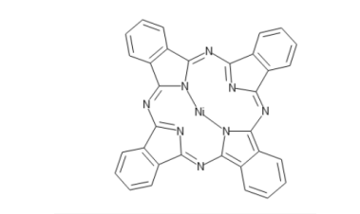
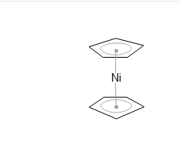
Nickel complexes Candidates
I am selecting a suitable nickel complex as transition metal Ni catalyst precursor for doping into MgH_{2.} Examples
Nickel acetylacetonate Ni(acac)₂
Nickel hydroxate Ni(OH)
NiCl₂・6(H₂O)
Nickel(II) phtalocyanine NiPc
CpNi Nickelocene
Notes:
I will compare several precursors, including Ni(acac)₂, NiCl₂·6H₂O, Ni(OH)₂, nickel phthalocyanine, and nickelocene.
These precursors have different ligand or nearest-neighbour environments around Ni, allowing their effects to be systematically investigated.

Slide 28
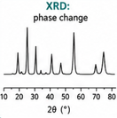
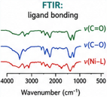
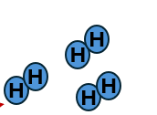
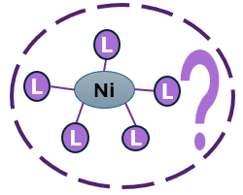
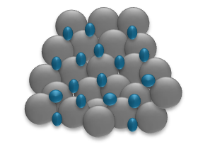
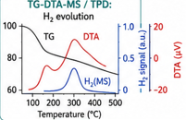
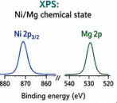
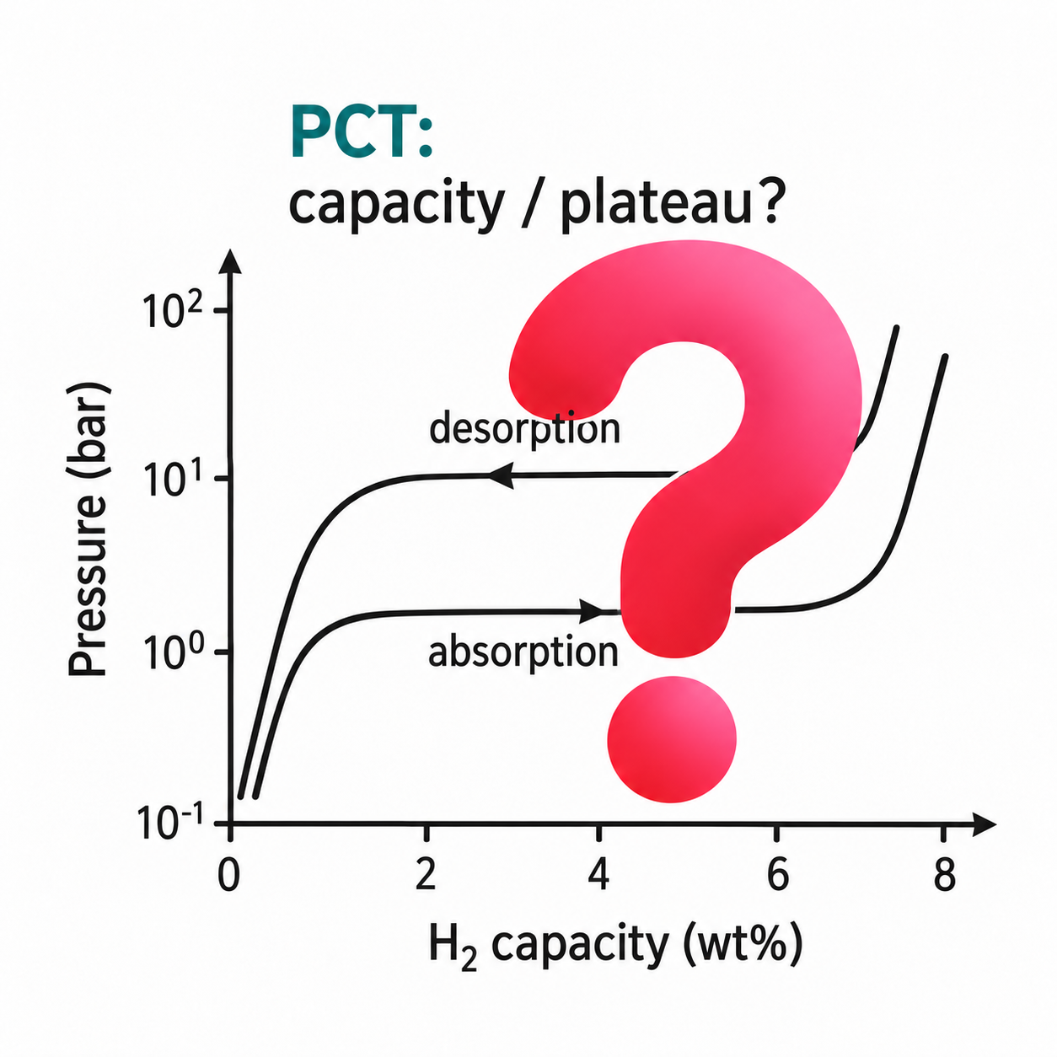
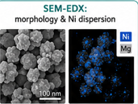
Characterisation Techniques
IR: Chemical Bonding
TG-DTA –QMS and TPD:
H₂ release temperature and activation energy
XRD: Crystallinity and phase identification
❓
XPS: (Surface) chemical states of Ni and Mg and (interfacial) bonding
❓
Hydrogen
desorption
❓
PCT: H₂ storage capacity
SEM-EDX and TEM: Morphology, Ni dispersion
Hydrogen
storage
❓
Notes:
Here are some characterisatio methods I will use to connect the material structure with its hydrogen-release and storage behaviour.I will combine structural, chemical, morphological, and hydrogen release/storage measurements to connect the material structure with its hydrogen-release and storage behaviour.
(I will use several complementary techniques.
XRD and IR will investigate phases and bonding.
XPS will investigate the chemical states of Ni and Mg and possible charge redistribution.
SEM-EDX and TEM will investigate morphology and Ni dispersion.
TG-DTA-QMS and TPD will evaluate hydrogen release, while PCT will evaluate hydrogen storage and cycling. )
(Here are the characteristation techniques I will use for my research. IR(full name of each characteristation), XRD, XPS , SEM-EDX and TEM will be used for all three samples, samples before and after heating for hydrogen release measurement. I will use TG-DTA and TPD , that is heating sample for hydrogen release measurement, temperature, and activation energy. I will use PCT to measure hydrogen uptake and storage capacity.)

Slide 29
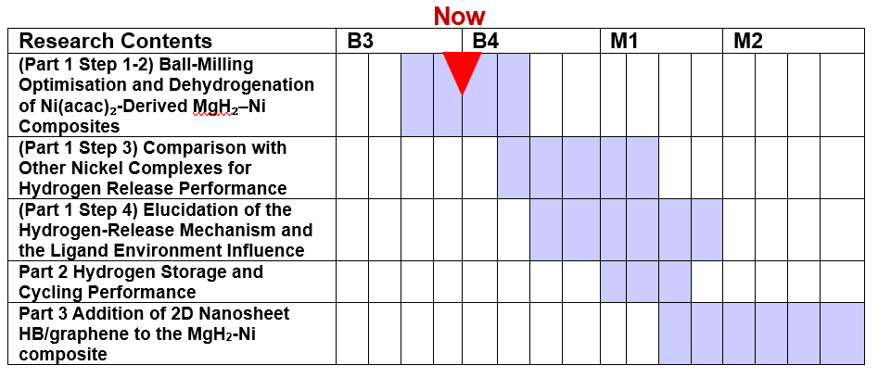
Research Plan Part 1 Investigation of MgH₂–Nickel Complex Composite Hydrogen Release/Dehydrogenation Property
Current Status
☑ Learning hydrogen release using metal hydrides and surface chemistry
☑ Learn experimental principles/theory and usage of each measurement equipment except PCT
☑ Ball mill 1) MgH₂ 2) MgH₂+ Ni(acac)₂ with two different methods to synthesise nanoscale MgH2+Ni composite and optimise ball milling conditions for future nickel complex-doped MgH₂ composites
☑ Measure hydrogen release performance of MgH₂+Ni(acac)₂ samples by TG-DTA-QMS
☑ Make TPD graph of H₂ release (m/z=2) of MgH₂+Ni(acac)₂ samples vs ball milled MgH2
☑ XRD of MgH2+Ni(acac)₂ samples
☑ IR of as-received nickel phtalocyanine
Learn PCT and hydrogen storage
Notes:
My current work focuses on the first part: improving MgH₂ hydrogen-release kinetics using nickel complex precursors.
(The part I am now researching on is the first part, comparison of addition of several nickel complexes on the thermal hydrogen release property of MgH2.
Before comparing different nickel complexes, I first research on the ideal and reproducible ball milling conditions to ensure better hydrogen release performance for future nickel complexes. I compare two different ball milling conditions. The first nickel complex I use is Ni(acac)2. )

Slide 30
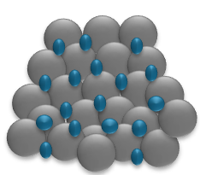
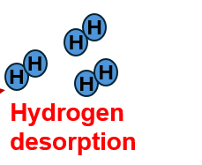

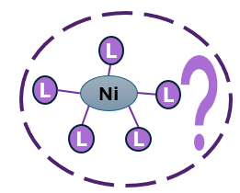
Standardised Methodology for Nickel Complexes
Starting materials
Ball milling in Ar atmosphere
Ball milled MgH₂+2 wt.% composite
Heating/ dehydrogenation by TG-DTA-QMS
MgH₂
2 wt. % Nickel complex
Mechano-mechanical process of mixing, doping, and nanosizing MgH₂+ nickel complex composite
Using Fritsch planetary ball mill, ball-to-powder ratio always 48:1
Heating each sample from 25-600 degrees Celcius under Ar flow, using TG-DTA coupled with simultaneous QMS with heating speed 10K/min
Then H₂ TPD (m/z=2)
Ball milling is the method to control crystalline size, grain size and surface states of particle sample. (M. Yuan, Master’s Thesis, 2023)
Notes:
Importantly, I will use the same MgH₂ composition, Ni loading, milling conditions, heating conditions, and characterization methods for every precursor. This allows me to isolate the effect of precursor chemistry as much as possible.
(Each nickel precursor will be added to MgH₂ at the same 2 weight percent loading and ball-milled under the same optimized conditions.
This controlled approach allows me to isolate the effect of precursor chemistry as much as possible, rather than differences in milling or catalyst loading. )

Slide 31
Characterisation methods
MgH₂, MgH₂-Ni, and MgH₂-Ni-2D nanosheet composites will be compared under standardised/identical conditions
I will investigate Hydrogen storage and cyclability tests
XRD and IR | Characterisation
TG-DTA-QMS and TPD | Hydrogen release
PCT | Hydrogen absorption-desorption, cyclability
SEM-EDX | morphology, agglomeration , elemental distribution
XPS | changes in the chemical states and interactions in chemical states
HB: investigate Mg–B / Ni–B interactions
Graphene: investigate Mg–C / Ni–C interactions
Notes:
(Skip if I don’t have time, just go back to this for Q and A)
Finally, I will compare MgH₂, MgH₂–Ni, and MgH₂–Ni–2D composites using structural, chemical, morphological, hydrogen-release, storage, and cycling measurements.
(Finally, I will compare MgH₂, MgH₂–Ni, and MgH₂–Ni–2D composites under identical conditions.
XRD and IR will examine structure and bonding, TG-DTA-QMS and TPD will examine hydrogen release, PCT will examine storage and cycling, SEM-EDX will examine morphology and dispersion, and XPS will investigate chemical states and interfacial interactions. )

Slide 32
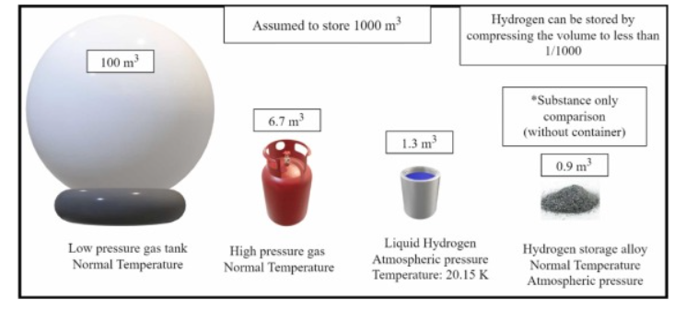
Introduction
Image from [1]
[2]
Carbon-neutral and sustainable
2H₂+O₂=> 2H₂O +electricity
High gravimetric energy density
Clean energy
Can replace fossil fuel
Solid-state hydrogen storage has the most effective volumetric storage capacity compared to gas hydrogen storage and liquid hydrogen
Requires lower pressure and is safer
[1] Klopčič et. al, A review on metal hydride materials for hydrogen storage, https://doi.org/10.1016/j.est.2023.108456.
[2] Adapted from M. Altaf et al., Energy Reports 13 (2025) 5746–5772; original source: Santoku Corporation.
[3] I. Farzat, PBL I-IV Reports, Bachelor’s Thesis, IDE, University of Tsukuba
Notes:
Hydrogen is considered a promising clean-energy carrier because its utilization can produce water without CO₂ emissions.
However, efficient and safe hydrogen storage is essential for practical hydrogen-energy systems.
I therefore focus on solid-state storage using metal hydrides.

Slide 33
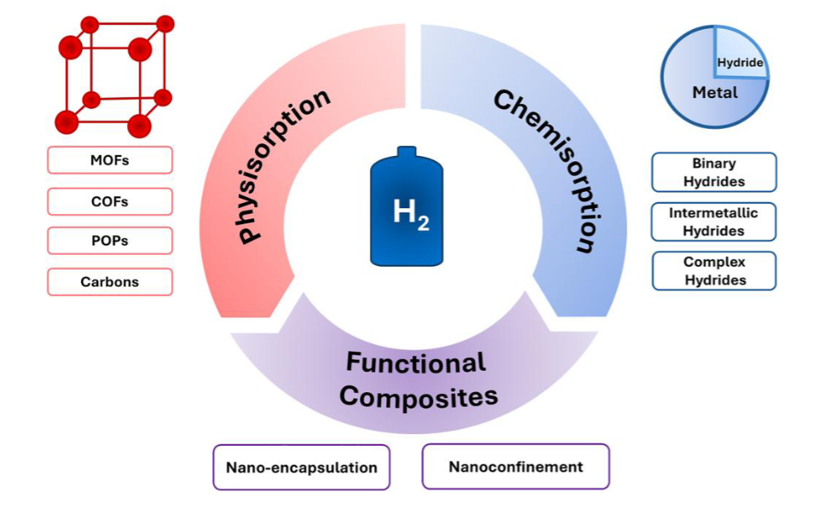

Solid State Hydrogen Storage and Metal Hydrides
Higher hydrogen densities
e.g MgH_{2,} TiH₂, …
P. Adelhelm and P. E. de Jongh, J. Mater. Chem. 21 (2011) 2417–2427.
Requirements
(1) Low H₂ release temperature and activation energy (high thermodynamics)
(2) Easy to restore H₂ (low kinetics)
(3) High stability (good reversibility)
Ahn et. al, Bulletin of the Chemical Society of Japan, Volume 99, Issue 2, February 2026, uoag011, https://doi.org/10.1093/bulcsj/uoag011
Limitation: sluggish kinetics, high H₂ release temperature and poor reversibility
Development of safer, cost-effective, and lightweight hydrogen storage materials is required. ​
[1] M. Yuan, Master’s Thesis Presentation, 2023
[2] N. Noguchi, Master’s Thesis Presentation, 2024
Notes:
Metal hydrides bond with hydrogen through chemisorption. Chemisorption-based hydrogen storage relies on the dissociation of hydrogen molecules into atoms, which then form strong chemical bonds with the storage materials. Due to these strong interactions, chemisorption materials can achieve higher hydrogen densities than physisorption-based systems. Metallic hydrides form when metals or alloys react with hydrogen, offering a safer and more efficient storage option than compressed or liquid hydrogen. These materials exhibit significantly higher hydrogen densities and operate under moderate temperatures and pressures. However, due to the strong metal-hydrogen bond, [limitations]. The requirements are []
Thus more safe, cost-effective hydrogen storage materials are required

Slide 34

Metal Hydrides for Hydrogen Storage
Image source: Google

Slide 35

DOE Regulations
Achievable
Achievable
Achievable
Very difficult/ Challenge
A long way to go!!
Ahn et. al, Bulletin of the Chemical Society of Japan, Volume 99, Issue 2, February 2026, uoag011, https://doi.org/10.1093/bulcsj/uoag011

Slide 36
Ni catalyst
Element/compound | Formation Enthalpy(kJ/mol)^{[2]}
Mg | -74
Mg₂Ni | -64 => greater thermodynamic instability=> improved kinetics
Ahn et. al, Bulletin of the Chemical Society of Japan, Volume 99, Issue 2, February 2026, , https://doi.org/10.1093/bulcsj/uoag011

Slide 37



Effect of Ni-based compounds on the dehydrogenation of MgH₂ ^{[1]}
Element bonded to Ni | Ni compound | Electronegativity of the element bonded to Ni | MgH₂ composite onset temp. | Activation Energy kJ/mol
C | (Ni₃C) | 2.55 | 160°C — best performance | 97.8 –best performance
N | (Ni₃N) | 3.04 | 180°C | 100.0
O | (NiO) | 3.44 | 205°C | 119.7
P | (Ni₂P) | 1.64 | 248°C — exception (forms Mg₂Ni + Mg₃P₂) | 132.5
C has best performance!
[1] Zhang et. al, https://doi.org/10.1016/j.ijhydene.2017.07.220
[2] Cui et. al, https://doi.org/10.1039/c4ta00221k
Notes:
More importantly, previous research suggests that Ni performance depends not only on the amount of Ni, but also on its chemical environment. (Animation)
For example, different elements bonded to Ni produce different MgH₂ dehydrogenation behaviours. When the element bonded to Ni has lower negativity, NiH bond destabilises, causing easier H2 release from MgH2. (Because of time constraint, don’t include example, later!)
(Ni₃C, Ni₃N, and NiO show different onset temperatures and activation energies.)
This suggests that the atoms surrounding Ni may influence hydrogen release through changes in bonding and electron transfer.

Slide 38

Cl as inhibiting factor
Galey reported increasing the NiPCy₃ content to 20 wt.% did not further improve dehydrogenation kinetics; instead, hydrogen was released at higher temperatures than with the 5 wt.% NiPCy₃ sample.
This unexpected result was attributed to the higher chlorine content in the NiPCy₃ complex, which acts as a kinetic inhibitor for MgH₂ decomposition and offsets the beneficial catalytic effect of the additional Ni
Galey, et.al ,International Journal of Hydrogen Energy 44 (2019) 11939-11952, Elsevier

Slide 39

Nickel Complex Tunes MgH₂ Properties
[1] J. Zhang et. al , International Journal of Hydrogen Energy 42 (2017) 28485-28497
Excellent catalytic ability of Nickel Phtalocyanine(Nickel Pc) : More electron transfer between NiPc and MgH₂-> weakened Mg-H bond and decreased dehydrogenation enthalpy of MgH₂
inducing more electron transfer between MgH₂ and neighbouring environment
NiN₄ centre in Nickel Pc has enhanced catalytic activity
N donation → increased electron density on Ni
Electron-rich Ni → destabilized Mg–H bonds
Weakened Mg–H bonds → enhanced dehydrogenation

Slide 40
Different Nickel Complex Preparation
Preparation: planetary ball milling under Ar atmosphere
Milling conditions: 300 rpm, 5 h
Ball-to-powder ratio: 100:1
Milling media: 1 mm ZrO₂ balls
Temperature control: paused every 2 min, rotation direction reversed every 5 min
Reference: MgH₂ milled without additives (m-MgH₂)
NiPCy₃ composites: MgH₂ + 5 or 20 wt.% NiPCy₃
Control additives: PCy₃ and Ni nanoparticles
20-(Ni + PCy₃): 1.7 wt.% Ni + 16.2 wt.% PCy₃
5-PCy₃: MgH₂ + 5 wt.% PCy₃
NiFe: MgH₂ + 10 wt.% Ni + 5 wt.% Fe
NiFe–NiPCy₃: NiFe + 5 wt.% NiPCy₃
Galey et. al, https://doi.org/10.1016/j.ijhydene.2019.09.127
Preparation: planetary ball milling under Ar
Milling conditions: 300 rpm, 5 h
Ball-to-powder ratio: 100:1
Milling media: 1 mm ZrO₂ balls
Temperature control: pause every 2 min, reverse direction every 5 min
NiHCl loading: 5, 10, 20, 25, 50 wt.%
NiH(BH₄) loading: 5, 10, 20 wt.%
Reference: MgH₂ milled without additive (100-MgH₂)
Galey et. al, https://doi.org/10.1016/j.ijhydene.2019.03.114
Ni(acac)₂ loading: 1, 3, 5, 7, and 10 wt.% in MgH₂
Ball milling: 1200 rpm, 5 h, under 1.5 MPa H₂
MgH₂–Ni–EG composition: 97:1.5:1.5 by mass
Comparison sample: MgH₂ + Ni powder + EG
Ball-to-sample ratio: ~50:1
Milling cycle: 30 min milling / 30 min pause
Shen et.al, Journal of Magnesium and Alloys 11 (2023) 3174-3185, Elsevier, https://doi.org/10.1016/j.jma.2021.12.003
Ni Pc loading: 10 wt% NiPc in MgH₂
Ball milling conditions: 1000 rpm, 2 h
Ball-to-powder ratio: 30:1
Cooling: 15 min pause after every 1 h milling
Samples: MgH₂ with 10 wt. % NiPc and/or 10 wt.% graphene
Zhang et. al, https://doi.org/10.1016/j.ijhydene.2017.09.170

Slide 41
[1.] Sankara Tatiparti from IIT Bombay, “Synergistic multi-catalyst strategies for kinetic enhancement of hydrogen storage in Mg-based nanocomposites for vehicular applications”, research lecture, 2026/06/18, in University of Tsukuba
[2] Duan et al., Journal of Magnesium and Alloys 13 (2025) 5624–5636. DOI: 10.1016/j.jma.2024.11.020. [3] Jin et. al Nature Communications 17 (2026) 2447. DOI: 10.1038/s41467-026-70604-y.
Charge of Mg also matters for hydrogen storage:
Mg charge/electron transfer → affects H₂ absorption & desorption kinetics
Dehydrogenation: electron transfer → Mg–H cleavage
Hydrogenation: electron transfer → MgH₂ formation
More negative Mg → faster H₂ release
More positive Mg → faster H₂ uptake
Ni ligand environment → may regulate interfacial electron transfer

Slide 42

Charge of Mg matters for hydrogen storage:
Ball milled Mg‑B‑electrochemically synthesised reduced graphene oxide (erGO) nanocomposite
Optimum B/C value for kinetics: 0.09 => shortest incubation period
B/C=0.09: Mechanism of increasing H-uptake kinetics
At B/C>0.09, the reception by B from Mg yields Mg-B interaction. The net charge acceptor role makes it electron-rich and doesn’t alter Mg unit cell significantly.
Despite charge donation to both C and B, the Mg charge is <2 -> difficult to bond with H -> long incubation time (>5h)at B/C=0.09
Mg
1.31
C
2.55
^{e- transfer}
^{e- transfer}
^{Mg expansion}
Mg
1.31
B (+)
2.04
^{repulsion}
Aditya et.al, Sci Rep 11, 10995 (2021). https://doi.org/10.1038/s41598-021-90531-w
Notes:
At B/C ≈ 0.09, B acts as a charge donor to C (B-C, Fig. 4a). The possible presence of the positively charged B in the octahedral interstices of Mg unit cell (ρOctahedral/ρmax, Fig. 3b, Supplementary Fig. S4) repels Mg (‘repulsion’,Fig. 5) and causes the lattice expansion

Slide 43
Reference Ball Milled MgH₂
Fritsch planetary ball mill
Ball milling parameters:
-ball:powder mass ratio 1:48, 7 balls,
-speed: 400 rpm
44 cycles (4 hours), 1 cycle: 5 min with 30s pause
reversible

Slide 44

XRD Result of Ball milled MgH₂
α-MgH₂ or β -MgH₂ can be used interexchangeably

Slide 45

XRD Result of Ball milled MgH₂ After Heating
hcp Mg
β MgH₂
MgO

Slide 46


Why 2 wt.% Nickel complex load?
Previous research (Shen et. al 2023) did 1 wt.%, 3wt.%, 5 wt.%, 7 wt.% and 10 wt.% loading of Ni(acac)₂
Also, it is reported that increased Ni(acac)2 loading MgH2+ x wt.% Ni(acac)2 decreases H2 storage capacity
Shen et.al, Journal of Magnesium and Alloys 11 (2023) 3174-3185, Elsevier, https://doi.org/10.1016/j.jma.2021.12.003

Slide 47

Ni(acac)₂ Promising Ni catalyst precursor

Slide 48

Ni(acac)₂ Poor cyclability
Good kinetics but poor cylability
Poor cycling stability of MgH₂–3 wt.% Ni(acac)₂
H₂ capacity decreased: 7.15 → 6.73 wt.% after 5 cycles
Performance degradation attributed to Mg/MgH₂ and catalyst agglomeration during cycling
Agglomeration leads to incomplete Mg hydrogenation
Shen et.al, Journal of Magnesium and Alloys 11 (2023) 3174-3185, Elsevier, https://doi.org/10.1016/j.jma.2021.12.003

Slide 49


Ni(acac)₂+EG Highly Promising Ni precursor
Prepared Extended Graphite(EG) with the same weight fraction was introduced to improve the cycle stability of the MgH₂, denoting as MgH₂+3 wt.% EG
${Ni(acac)}_{2}+EG:$ improve cyclability and to the best of the authors’ knowledge highest hydrogenation-dehydrogenation capacity of 7.03 wt% at 300$℃$ for ${MgH}_{2}$ composites. Keeps cyclability after 10 cycles.
Shen et.al, Journal of Magnesium and Alloys 11 (2023) 3174-3185, Elsevier, https://doi.org/10.1016/j.jma.2021.12.0

Slide 50

: β-MgH₂ vs γ-MgH₂ structure₂
Both α- and β- MgH₂ have tetragonal structure
γ-MgH₂ have orthorhombic structure
Pluengphon et. al(2019). International Journal of Hydrogen Energy. 44. 10.1016/j.ijhydene.2019.06.066.

Slide 51

: How Metal Hydrides are Formed: α-phase vs β-phase
Ahn et. al, Bulletin of the Chemical Society of Japan, Volume 99, Issue 2, February 2026, uoag011, https://doi.org/10.1093/bulcsj/uoag011
Step 1: hydrogen molecules disassociate into reactive atoms, which then diffuse into the bulk material and undergo chemisorption within the metal or alloy lattice
Step 2: During hydrogen absorption, the host metal initially dissolves hydrogen to form a solid solution (α-phase)
Step 3: As the hydrogen concentration in the metal increases with in-creasing pressure, nucleation occurs, leading to growth of the hydride phase (β-phase)

Slide 52
: β-MgH₂ vs γ-MgH₂ structure₂
In literature, the low temperature tetragonal phase β-MgH₂ transforms into the high pressure orthorhombic phase γ-MgH₂ after being treated at high pressures (2.5 to 8GPa) and high temperatures (250 to 900C) for 1 to 3 hours.
It is also reported that the β-MgH2 phase partially transforms into a metastable γ-MgH2 phase under a high compressive stress.
β-MgH₂ and γ-MgH₂ are different phases of MgH₂.
Low temperature tetragonal β-MgH₂→ high-pressure orthogonal γ-MgH₂ phase after being treated at high pressures and high temperatures for 1-3 hours ^{[2]}
Bastide et.al, Mater. Res. Bull. 15 (1980) 1215-1224.

Slide 53


Result: Hydrogen release Property
Only 2 wt.% Ni(acac)₂ → lower H₂-release temperature compared to ball milled and esp. commercial MgH₂
Broader desorption peaks → compared with sharp commercial MgH₂ peak
m/z=2
Dehydrogenation Temperature ($℃$)
Sample | Onset (Begin to release H₂) | Peak
Ball milled MgH₂ | 310 | 350.3
Gently ball milled MgH₂+2wt. % Ni(acac)₂ | 257.86 | 337.271
Intensive ball milled MgH₂+2 wt.% Ni(acac)₂ | 260.43 | 288.27 (lowest)
TG–MS analysis of the as-received(commercial) MgH₂ sample, carried out at 10 °C min⁻¹ heating rate
Campostrini et.al, J Therm Anal Calorim, DOI 10.1007/s10973-013-3539-8
Notes:
The key result is that both Ni(acac)₂-containing samples released hydrogen at lower temperatures than ball-milled and commercial MgH₂. The main peak was approximately 337 degrees for the gentle sample, but only 288 degrees for the intensive sample. Therefore, intensive milling gave the most favourable hydrogen-release behaviour.
(The hydrogen-release measurements showed that both Ni(acac)₂-containing samples released hydrogen at lower temperatures than ball-milled MgH₂, and much lower than commercial MgH2
(The onset was approximately 258 degrees for the gentle sample and 260 degrees for the intensive sample.)
More importantly, the intensive sample showed its main peak at approximately 288 degrees, compared with 337 degrees for the gentle sample. )

Slide 54
Why are Ni(acac)₂ H₂ release peaks broader than pure MgH₂?
Although the hydrogen release temperature of Ni(acac)₂ samples are lower, the hydrogen release peaks are broader than sharp peak of commercial/as prepared MgH₂ and ball milled MgH₂
Broader peaks might be due to there are many chemical species in Ni(acac)₂ => diversity
For practical storage applications and utilisation such as in fuel cell, narrower H₂ release peaks are easier to control than broad ones

Slide 55

Result: Hydrogen release Property of Ball milled MgH2+2 wt.% Ni(acac)₂ Composites
Multistep, multipeak hydrogen release for both samples
Intensive ball milled sample: 2 main peaks at 288.27°C and 329.52 °C
Gentle ball milled sample: 3 main peaks at 284 °C , 337 °C, and a high temperature peak at 392.84 °C
Broad low temperature peak at both samples at around 66-133 °C, may be a characteristic of Ni(acac)₂
Plan: Investigate by doing TG-DTA of Ni(acac)₂ by itself
The high temperature peak is possibly due to MgH₂ domains insufficiently activated by the Ni(acac)2 derived catalyst
No detectable Mg₂Ni (supported by XRD)→ limited H₂-transfer pathway /“hydrogen pump effect”
Possible uncatalysed MgH₂ regions
Notes:
The gentle sample also showed an additional high-temperature feature around 393 degrees.
Since crystalline Mg₂Ni was not detected in this sample, this peak is unlikely to originate simply from sequential Mg₂Ni and MgH₂ decomposition.
It may instead indicate MgH₂ regions that were insufficiently activated by the Ni-derived catalys

Slide 56
Hydrogen Pump Mechanism
“….These enhancements originated from the “hydrogen pump” effect generated by the in situ formed Mg₂Ni/Mg₂NiH₄ during the hydrogen absorption and desorption process:”
Upon hydrogen absorption,Mg₂Ni preferentially adsorbs hydrogen to the Mg interface, promoting the hydrogenation of Mg
Upon hydrogen desorption, Mg₂NiH₄ preferentially decomposes to release hydrogen and introduces disordered regions and mechanical stress at the interface, there by accelerating the decomposition of MgH₂”
Wen et. al, “Enhanced “Hydrogen Pump” Effect in Improving the Hydrogen Storage Performance of MgH2 via the Introduction of a Flower-like NiCu Bimetallic MOF”, 2026

Slide 57


Ni(acac)₂ Hydrogen Pump
Shen et.al, Journal of Magnesium and Alloys 11 (2023) 3174-3185, Elsevier, https://doi.org/10.1016/j.jma.2021.12.003
Reaction pathway (evolution pathway) of ${Ni(acac)}_{2}$
${MgH}_{2}$+ ${Ni(acac)}_{2}→$MgO+ Ni
$$MgH2+Ni→Mg2Ni$$
$MgNi+H_{2}$ $→{Mg}_{2}{NiH}_{4}$ “hydrogen pump” for enhancing ${MgH}_{2}$storage properties: breaking Mg-H bond
The highly dispersed Mg₂Ni/Mg₂NiH₄ provides a large number of active sites for the hydrogen absorption/desorption reactions of MgH₂ => reduce the dehydrogenation activation energy and accelerate its hydrogen de/absorption kinetics.

Slide 58


$D(nm)=\frac{kλ}{βcosθ}$
Scherrer Equation Crystal Size
where $k$= dimensionless shape factor . For spherical crystals with cubic unit cells typically 0.89
$λ$= X-ray wavelength. For Cu K$α$ radiation, 0.154 nm
$β=$FWHM (rad)
$θ$ = Bragg angle (rad)

Slide 59

Scherrer Equation Crystal Size
Samples after TG (heating)/hydrogen release
Sample | Average crystalline size (nm)
Gently ball milled MgH₂+2 wt.% Ni(acac)₂ | 41.856
Intensively ball milled MgH₂+2 wt.% Ni(acac)₂ | 9.426
Ball milled MgH₂ (7 balls) | 37.402
Smaller, well-dispersed catalyst particles enhance catalytic activity
Gentle milling → largest crystallite size after dehydrogenation
Possible thermal recovery/recrystallisation → grain growth
Likely agglomeration during heating
Intensive milling → smallest crystallite size
Possible causes: higher defect density & residual microstrain
Better Ni dispersion → finer Mg-based domains
Harsher milling → Possible suppressed grain growth
We will investigate Ni(acac)₂ dispersion using TEM
Notes:
After dehydrogenation, the intensive sample retained much smaller crystallites than the gentle sample, suggesting that milling conditions also affect structural evolution.
(After dehydrogenation, the gently milled sample showed substantially larger crystallites, while the intensively milled sample retained much smaller crystallites.
This may be related to differences in defect density, microstrain, and Ni dispersion, but further characterization is necessary.)

Slide 60

Scherrer Equation Crystal Size
Samples before TG-DTA/heating
Sample | Average crystalline size (nm)
Gently ball milled MgH₂+2 wt.% Ni(acac)₂ | 8.458
Intensively ball milled MgH₂+2 wt.% Ni(acac)₂ | 8.859
Ball milled MgH₂ (4 balls) | 8.251

Slide 61
Ball milled MgH2
-Sample mass 10.9 mg
-Hydrogen calibration was performed at room temperature by injecting H₂ volumes for 0.01,0.05, 0.1, 0.2 and 0.5 mL
TG-DTA Procedure
TG–DTA was combined with hydrogen temperature-programmed desorption (H₂-TPD) using a STA-2500 NETZCH Regulus analyser under argon flow. The evolved gases were transferred through a capillary to a quadrupole mass spectrometer and monitored
For each ball milled Ni(acac)₂ samples
-Sample mass of intensive: 9.7 mg
-Sample mass of gentle:
8.8 mg
Hydrogen calibration was performed at room temperature by injecting H₂ volumes for 0.01,0.05, 0.1 and 0.5 mL
All samples were heated from 25 to 600 °C at 10 K min⁻¹. The TG–DTA data were recorded using NETZSCH software and subsequently processed in Excel to obtain the H₂-TPD profile.
TPD graph analysis , multipeak fitting, and onset temperature determination are done in Igor software

Slide 62
Raw TG-DTA
Based on the TG weight loss calculation of the main peak from the raw data:
Intensively ball milled MgH₂-Ni(acac)₂ sample (6.4214% +4.748%=11.594%) >ball milled MgH₂ sample (6.0137%)> gently ball milled sample MgH2-Ni(acac)₂ (5.277%).
This may indicate that the intensively ball milled sample releases the highest quantity of H₂ desorption. However, further data processing is needed to isolate only hydrogen components (m/z=2).
All samples show endothermic reaction

Slide 63

Raw TG-DTA MgH₂

Slide 64

Raw TG-DTA Intensive MgH₂-Ni(acac)₂

Slide 65




Processed TG-DTA
TG weight loss of intensively ball milled sample> that of gently ball milled sample
=> More gas is released from the intensively b.m sample
A. Trevanna, PBL II report IDE

Slide 66

Raw TG-DTA Gentle MgH₂-Ni(acac)₂

Slide 67
Conclusion and Future Plan
Ni(acac)₂ lowered H₂-release temperature; milling conditions affected performance
Intensive milling → most favourable H₂-release behaviour
Possible Mg₂Ni formation → enhanced H₂ transfer (“hydrogen pump”), supported by XRD
Intensive milling may be selected as the standard condition
Initial temperature alone is insufficient to evaluate catalyst performance
Further clarify: phase formation, Ni dispersion, MgH₂–Ni interfaces, multistep release & structural evolution
These points must be resolved before different nickel complex precursors can be compared reliably
We will do IR of each sample
TEM and SEM-EDX to examine Ni(acac)₂ derived Ni dispersion
Calculate H₂ wt. % release
Notes:
From this study, I found that Ni(acac)₂ lowers the hydrogen-release temperature and that milling conditions strongly affect its performance. However, temperature alone is insufficient to evaluate the catalyst. Phase formation, Ni dispersion, interfacial contact, and the origin of the multiple peaks still need to be clarified.
(From these results, I found three important points.
First, Ni(acac)₂ can lower the hydrogen-release temperature.
Second, milling conditions strongly affect the resulting hydrogen-release behaviour.
Third, temperature alone is not sufficient to evaluate the catalyst.
Therefore, I need to clarify phase formation, Ni dispersion, interfacial contact, and the origin of the multiple release peaks)
(Ni(acac)₂ lowered the H₂-release temperature of MgH₂, depending on milling conditions
Intensive milling gave the most favourable H₂-release behaviour
Mg₂Ni formation may promote H₂ transfer (“hydrogen-pump” effect) in the intensively ball milled smaple supported by XRD results
Intensive milling may be selected as the standard condition for precursor comparison
However, initial release temperature alone is insufficient to evaluate catalyst performance
Phase formation, Ni dispersion, MgH₂–Ni interfaces, multistep release, and structural evolution must be clarified
These points must be resolved before different nickel complex precursors can be compared reliably.)

Slide 68

_{Future Plan}
We will do IR of each sample
TEM and SEM-EDX to examine Ni(acac)₂ derived Ni dispersion

Slide 69


Future Research: Comparison of Nickel Complexes Precursor for Improved Hydrogen Release Performance of MgH₂
Notes:
Because my current results show that milling conditions affect the Ni-containing species and H₂-release behaviour, I will next compare different Ni precursors under identical better milling conditions. The next step is to determine how different Nickel complex precursors influence MgH₂ dehydrogenation. We want to induce ideal Ni and Mg charge state/bonding for hydrogen release .
(Here, we want to find which nickel complex precursor improves MgH2 hydrogen release)
We want to induce ideal Ni and Mg charge state/bonding for hydrogen release from Ni-neigbouring element and Mg-neighbouring element interactions

Slide 70
Future Plan: Nickel complexes Candidates
I am selecting a suitable nickel complex as transition metal Ni catalyst precursor
Temperature
Speed
Capacity
The closest element to Ni in the nickel complex is an important factor
What To Consider/ Factors
Cyclability/Durability
Catalytic mechanism
From Zhang et. al (2016), it suggests that compounds containing Ni bonded to C might be promising, followed by Ni-N bond for dehydrogenation performance
However, from Galey (2019), Cl is kinetic inhibiting
Reaction pathways
Notes:
I will evaluate hydrogen-release, kinetics, temperatirehydrogen capacity, catalytic mechanism, and cycling stability, . In particular, I will investigate whether the chemical environment around Ni correlates with hydrogen-release performance
(I will evaluate each precursor using several factors: hydrogen-release temperature, hydrogen capacity, reaction kinetics, cycling stability, and catalytic mechanism.
In particular, I will investigate whether the chemical environment around Ni correlates with hydrogen-release performance.)

Slide 71



Calculate activation energy
Kissinger equation
Heating rate
$β$= Heating rate (\(dT/dt\))
T_{p}= Peak temperature (the temperature where the reaction or transition rate reaches its maximum, often found via DSC analysis
E_{a}= Activation energy
R = Universal gas constant
A= Pre-exponential factor
Subject to different heating speeds

Slide 72
The importance/novelty of my research
My research aims to systematically isolate the effect of Ni precursor chemistry by comparing different nickel complexes under identical conditions, and then connect the precursor-derived Ni chemical environment and MgH₂–Ni interface to hydrogen-release and storage behaviour.

Slide 73



Nickel phtalocyanine
Sample | Milling Time (hours) | Onset and Peak Temperature | Better /Lower Dehydrogenation Temperature ${MgH}_{2}$ ?
$${MgH}_{2}$$ | 2 | 404.5 $℃$ and 429.8 $℃$ | -
${MgH}_{2}$ +10 wt%NiPc | 2 | 310.4 $℃$and 326.4 $℃$ | Best performance
${MgH}_{2}$ +10 wt%NiPc+ 10wt% G/${MgH}_{2}$ +5wt%NiPc+ 5wt% G , NiPc and G simultaneously ball-milled | 2 | 425.8$℃$ and 466.7 $℃$ /: 447.2 $℃$ and 464.7 $℃$ | Worst , i.e higher dehydrogenation temperature
${MgH}_{2}$ +10 wt%NiPc (1hr.)+ 10wt% G (1hr.): | Separate addition and milling of NiPc and G | 415.4 $℃$ and 461. 0 $℃$ | Still worse
 |  | 392.5 $℃$ and 421.7 $℃$ | second best performance
Excellent catalytic performance on dehydrogenation properties of ${MgH}_{2}$+NiPc , gives better dehydrogenation performance compared to either ball milled ${MgH}_{2}$ or, (surprisingly) ${MgH}_{2}+NiPc+Graphene$ (G) composite (DSC measurement)
Excellent catalytic performance on dehydrogenation properties of MgH2 due to NiPc , which has overlapping orbital , promotes electron transfer (more than G) -> weakens Mg-H bond, which decreases Mg-H bond stability (from calculations)
However, co-milling NiPc+graphene leads to worse performance

Slide 74
Nickel phtalocyanine and graphene: Ball milling method
Why simultaneously milling NiPc and G with MgH2 gives worst performance:
1) NiPc → strong catalytic effect, but weak anti-agglomeration ability
2) Graphene (G) → strong anti-agglomeration effect, but limited catalytic activity
Sequential G → NiPc addition → synergistic effects
→ G suppresses MgH₂ agglomeration; NiPc promotes MgH₂ decomposition
MgH₂ + 10 wt.% G (1 h) + 10 wt.% NiPc (1 h) → improved dehydrogenation performance
From this paper, a possible method for me to mix 2D material to nickel complex will be to compare hydrogen release/storage performance of 1) co-milling nickel complex and 2D nanosheet (such as graphene) with MgH2
2) sequential ball milling of MgH2 and 2D nanosheet, followed with ball milling nickel complex

Slide 75

Ni(OH)
Due to the promising hydrolysis ability, it’s reasonable to want investigate its hydrogen release ability
Chen et.al, Chem. Mater. 2025, 37, 9004−9013
NiO/Ni(OH)₂ heterostructure (2 wt.%) → 880.2 mL g⁻¹ H₂ in 20 s at 30 °C
Nearly 100% Mg conversion; 820.1 mL g⁻¹ H₂ even at 0 °C
Ball milling → homogeneous Ni/O distribution & enhanced H₂ diffusion

Slide 76
Why Combine Metal Hydrides and 2D Materials?
Ahn et. al, Bulletin of the Chemical Society of Japan, Volume 99, Issue 2, February 2026, uoag011, https://doi.org/10.1093/bulcsj/uoag011
Physisorption materials (e.g., graphene): weak H₂ binding → poor ambient-temperature storage
Chemisorption materials (e.g., metal hydrides): strong H₂ bonding → slow kinetics & high desorption temperature
Hybrid composites: combine high H₂ capacity of metal hydrides with kinetic enhancement from 2D supports
2D nanosheets suppress grain aggregation and aid in dispersion of nanoparticles → improve cycling stability
Nano-encapsulation using graphene, reduced graphene oxide, polymers, or MXenes also minimises dead space compared to scaffolded structures
→ higher metal hydride loading and hydrogen storage capacity

Slide 77
Carbon-based materials as 2D nanosheets
Carbon additives act as grinding aids → suppress Mg/MgH₂ grain growth during cycling
Carbon allotropes-> large surface area & high porosity → more adsorption sites and improved H₂ storage
Graphene-based composites are promising as they not only improve hydrogen release kinetics of the active phase but alsominimize its oxidation and agglomeration with minimal loss ofgravimetric capacity.
Ex: graphene, rGO

Slide 78
Graphene
High surface area and active sites → Graphene support → in situ growth of MgH₂ nanoparticles
Graphene based composites(e.g rGO) → faster H₂ release, less oxidation & agglomeration
Minimal loss of gravimetric capacity
Well-dispersed ~3 nm MgH₂ + graphene confinement → improved H₂ storage
Desorption peak: 318 °C → 62 °C lower than pure MgH₂ [1]
[1] Q. Zhang et. al, ACS Appl. Nano Mater. 28 June 2019; 2 (6): 3828–3835.
[2] Ahn et. al, Bulletin of the Chemical Society of Japan, Volume 99, Issue 2, February 2026, uoag011, https://doi.org/10.1093/bulcsj/uoag011
[3] A. Klechikov, et.al , Chem. Commun. 2015, 51, 15280. https://doi.org/10.1039/C5CC05474E
Notes:
On the basis of high surface area and active sites, graphene is chosen as support material to in situ grow MgH₂ nano-particles
The well-dispersed MgH₂nanoparticles (∼3 nm) and the confinement effect of graphene result in the improved hydrogen storage properties
The peak hydrogen desorption temperature of MgH₂ nano-particle−10 wt % graphene nanosheet composites is 318 °C, which is 62 °C lower than the pure MgH ₂

Slide 79
Defects in Graphene
Weak H₂ physisorption limits carbon-based storage
Defects & heteroatoms induce surface polarity
Surface polarity → enhanced H₂ adsorption
Defective sites prevent graphene aggregation → preserve high porosity [1]
KOH-activated graphene: 4 wt.% H₂ at 193 K and 120 bar [2]
[1]
[2] A. Klechikov et.al , Chem. Commun. 2015, 51, 15280. https://doi.org/10.1039/C5CC05474E
Ahn et. al, Bulletin of the Chemical Society of Japan, Volume 99, Issue 2, February 2026, uoag011, https://doi.org/10.1093/bulcsj/uoag011
Ahn et. al, Bulletin of the Chemical Society of Japan, Volume 99, Issue 2, February 2026, uoag011, https://doi.org/10.1093/bulcsj/uoag011

Slide 80
Graphene Preparation Methods: Ball milling
Ball Milling for Graphene Production
Top-down exfoliation of graphite → graphene nanosheets
Mechanical impact & shear forces → layer exfoliation
Simple, low-cost & scalable
Dry milling: solvent-free & simple
Wet milling: solvent-assisted → lower frictional heat & faster exfoliation
Wet milling requires additional separation & drying steps
Dry vs. Wet Ball Milling
Both methods: thinner graphene/GO + more defects + lower crystallinity
Wet milling: more homogeneous & higher-quality graphene
→ electronics, sensors & energy
Dry milling: higher oxygen functionality
→ adsorption, catalysis & composites
Dry milling: simpler, cheaper & more environmentally friendly for scale-up
Hutapea et.al, Micro 2025, 5, 40.
https://doi.org/ 10.3390/micro5030040

Slide 81



HB and Ni/HB
HB
Ni/HB
High dispersion ability
Has 8.5 wt% H₂ capacity
HB can support Ni in nanoparticle form through metal reduction of Ni²⁺
Highly dispersed Ni nanoclusters on HB → potential for catalytic+ hydrogen storage applications
S. Ito, et al., Chem. Lett. 2020, 49, 789.
[1] Kondo et. al , J.Am.Chem.Soc.2017, 139, 1376113769
[2] Kawamura et. al, Nat Commun 10, 4880 (2019). https://doi.org/10.1038/s41467-019-12903-1
[3] N. Noguchi, et al., Molecules 2022, 27(23), 8261

Slide 82
MgH₂-Ni-2D Synthesis method
A 1:1 ratio of Nickel complex and 2D nanosheet will be mixed by ball-milling into MgH₂ composite for balancing
-> MgH₂: 2wt.% Nickel complex: 2 wt% 2D nanosheet
Zhang et. al (2017) reported worst dehydrogenation results of co-milling MgH₂+5/10 wt.%NiPc+5/10 wt.% graphene(G) (highest hydrogen release temperature), and the second best performance after MgH2+10 wt.% NiPc is after sequential addition of 10 wt.% G+10 wt.% NiPc
The order and method of combining the catalyst and support may be important, which I will investigate in my system
Thus, I will first optimise ball milling conditions by comparing whether it is better to co-mill mickel complex +2D nanosheet, sequential addition of nickel complex then 2D nanosheet, or sequential addition of 2D nanosheet then nickel complex into MgH₂ through TG-DTA and TPD
-> lowest hydrogen release temperature?
Notes:
I will synthesise MgH₂ with 1:1 ratio of 2 weight percent nickel complex and 2 weight percent 2D material. I will also compare different preparation sequences, including simultaneous and sequential ball milling, because the order of adding the catalyst and 2D material may influence their interaction and the resulting hydrogen-release performance. I will identify the preparation method giving the best hydrogen-release performance
(I will compare different ways of combining the Ni precursor and 2D material, including simultaneous and sequential ball milling.
The initial composition will be MgH₂ with 1:1 ratio of 2 weight percent nickel complex and 2 weight percent 2D material. I will identify the preparation method giving the best hydrogen-release performance.)
(Previous work on NiPc and graphene showed that simultaneous milling did not necessarily give the best performance.
Sequential addition of graphene followed by NiPc gave better results than simultaneous addition.
This suggests that the order and method of combining the catalyst and support may be important, which I will investigate in my system)

Slide 83
If I select HB…
Synthesise MgH₂-Nickel complex-HB nanosheet
Compare MgH₂-Nickel Complex-HB composite’s hydrogen release and storage property with MgH₂-Ni/HB
MgH₂- conventional Ni-acac₂ derived Ni/HB : compare with literature (N. Noguchi, Master’s Thesis, 2024)
MgH₂-ligand free NiCl·H₂O derived Ni/HB: do research? <= No research on this yet
Then synthesise MgH₂-Nickel complex-Ni/HB nanosheet
Compare MgH₂-Nickel Complex-HB composite’s hydrogen release and storage property with MgH₂-Nickel Complex-Ni/HB
Elucidate reaction mechanism

Slide 84


MgH₂+Ni/HB
In MgH₂–Ni/HB composites,
Ni → promotes H₂ transfer & recombination
HB → maintains Ni/MgH₂ dispersion
MgH₂–Ni/HB @ only 2 wt.% Ni/HB → H₂ release at approx. 550 K → ~50 K lower than ball-milled MgH₂
N. Noguchi, Master’s Thesis and Presentation, 2024
Notes:
In MgH₂–Ni/HB composites, Ni promotes hydrogen transfer and recombination, while HB helps maintain Ni and MgH₂ dispersion. Previous work reported hydrogen release at approximately 550 Kelvin with only 2 weight percent Ni.
(Ni/HB has highly dispersed and uniform Ni nanoclusters on HB, good catalytic potential. In MgH₂–Ni/HB composites, Ni promotes hydrogen transfer and recombination, while HB helps maintain Ni and MgH₂ dispersion.
Previous work reported hydrogen release at approximately 550 Kelvin with only 2 weight percent Ni, about 50 Kelvin lower than ball-milled MgH₂. )
(In MgH₂–Ni/HB composites, Ni promotes hydrogen transfer and recombination, while HB helps maintain the dispersion of Ni and MgH₂.
MgH₂–Ni/HB containing only 2 wt.% Ni released hydrogen at approximately 550 K, about 50 K lower than ball-milled MgH₂, demonstrating improved hydrogen-release kinetics with
MgH₂-Ni interface contact is a key for Mg nucleation, which makes the Mg/MgH₂ dehydrogenation reaction starts sooner and the overall desorption rate increases.
a low catalyst loading)

Slide 85

N. Noguchi, Master’s Thesis, University of Tsukuba, 2024
Ni/HB vs HB Hydrogen Release
Notes:
How the Ni nanoclusters are involved in the hydrogen release of HB (Figures 3-8).
First, we discuss the hydrogen release profile of the original HB and how and where the detected
hydrogen was released from the HB sheet. For the low-temperature part (blue), the hydrogen release
from the interlayers of HB sheets are expected rather than within HB sheet because the distance
between hydrogen atoms is the shortest44,. Various layer-layer distance may cause slightly different
release temperature in this range and consequently broader peak may appear. For the mediumtemperature part(yellow), hydrogen release from the surface of HB sheet is expected, which creates
hydrogen vacancies and finally recombination of hydrogen atoms away from the sheet surface(red).
Therefore, we speculate that the hydrogen release profile is broad.
Next, we consider the same procedure for Ni0.1/HB1. For the low-temperature part (350~450 K),
the peak at low temperatures disappears because the Ni nanoclusters form between the layers, which
widens the distance between the hydrogen atoms and prevents recombination at low temperatures.
The reason for the disappearance of the broad peak for the high-temperature part (1000 K~1400 K)
is thought to be that the Ni nanoclusters help the recombination of hydride (H-
+H-
→H2) on the HB
surface, enabling the overall release at the medium temperature part (450~1000 K).

Slide 86
Features and disadvantage of ball milling
Advantage:
-Simple method, not requiring further chemical agents to synthesise a material
-Can decrease crystalline size to nanometre scale
- Cause defects, which eases metal hydride nucleation and H₂ diffusion, leading to improved hydrogen sorption kinetics
Disadvantage:
-Uneven distribution of crystalline size
-Can agglomerate

Slide 87
Ball milling Effect
Crystall size
Grain size
(Surface) oxide layer
Time
… many factors

Slide 88

Graphene Preparation Methods: Ball milling
Hutapea et.al, Micro 2025, 5, 40.
https://doi.org/ 10.3390/micro5030040

Slide 89

MgH₂+HB
Amount of MgH₂ is increased => the peak on the high-temperature side becomes larger.
K. Goto, Master’s Thesis, 2023
N. Noguchi, Master’s Thesis, 2024

Slide 90

HB Synthesis Method
1. Starting material
MgB₂ + strongly acidic cation-exchange resin
2. Ion-exchange reaction
Mg²⁺ / H⁺ exchange in acetonitrile or methanol
3. Exfoliation
→ Formation of 2D hydrogen boride (HB) nanosheets
4. Reaction conditions
N₂ atmosphere • Room temperature • Ambient pressure • 3 days stirring
5. Separation & drying
Filtration → drying at 343 K under N₂
6. HB product
Yellow HB powder (reported ~42.3% yield)
7. Byproduct removal
B(OH)₃ formed by hydrolysis
→ Methanol route: B(OH)₃ → trimethyl borate → evaporation
Kondo et. al , J.Am.Chem.Soc.2017, 139, 1376113769

Slide 91

Conventional Ni/HB Synthesis
Already used for MgH₂-Ni/HB composite hydrogen release and storage research
N. Noguchi, Master’s Thesis and Presentation, 2024

Slide 92

How to Synthesise MgH₂-Ni/HB
N. Noguchi, Master’s Thesis and Presentation, 2024

Slide 93

Hydrogen in the Composites
From N. Noguchi Master’s Thesis Presentation 2024
However, there is still Ni(acac)₂ residues

Slide 94

Ligand-Residue Free Ni/HB
Y. Tamegai, Bachelor’s Thesis and Presentation, University of Tsukuba, 2026

Slide 95

Ligand-Residue Free Ni/HB synthesis
Y. Tamegai, Bachelor’s Thesis and Presentation, 2026

Slide 96


Ligand-Residue Free Ni/HB: XPS
Y. Tamegai, Bachelor’s Thesis and Presentation, 2026

Slide 97

Ligand-Residue Free Ni/HB
Y. Tamegai, Bachelor’s Thesis and Presentation, 2026

Slide 98
Experimental Principles

Slide 99

X-Ray Diffraction
Molecules 2024, 29(21), 5014; https://doi.org/10.3390/molecules29215014
For characterizing the crystallographic structure, phase composition, and structural changes in hydrogen storage material
It allows for the identification of the hydrogen storage phases, the determination of the phase abundances, and the study of phase transitions during the hydrogen sorption processes
Principle:
X-rays interact with crystal planes → diffraction
Diffraction angles & intensities → crystal structure and lattice parameters
Bragg’s law → determines atomic arrangement from diffraction pattern

Slide 100
FT-IR
IR spectroscopy identifies the chemical structure and bonding of materials by measuring infrared absorption associated with molecular vibrations.
Because each compound has a unique vibrational spectrum, IR is particularly useful for characterizing nickel complexes and confirming their molecular structures. Infrared absorption occurs only when molecular vibrations produce a change in dipole moment, making IR effective for identifying functional groups and chemical bonding environments
N. Noguchi Master’s Thesis, 2024, University of Tsukuba

Slide 101

My Obtained IR of Nickel Phtalocyanine

Slide 102

XPS
Molecules 2024, 29(21), 5014; https://doi.org/10.3390/molecules29215014
Surface-sensitive technique that provides valuable information about the elemental composition, chemical states, and electronic structure of hydrogen storage materials
Principle:
XPS uses X-rays to eject photoelectrons from a sample surface
Photoelectron kinetic energy → elemental composition & binding energy
Binding-energy shifts → chemical states / charge distribution
Surface-sensitive analysis of elements and their chemical states

Slide 103


SEM (Scanning Electron Microprobe)
Molecules 2024, 29(21), 5014; https://doi.org/10.3390/molecules29215014
SEM provides high-resolution images of the surface morphology and microstructure of hydrogen storage materials => examine particle size, surface roughness, porosity, agglomeration, and structural defects, all of which influence hydrogen diffusion, adsorption, and long-term cycling stability.
SEM is therefore valuable for correlating microstructural changes with hydrogen storage performance
https://myscope.training/SEM_Structure_of_an_SEM
Principle:
A primary electron beam is rastered over the sample surface where it creates secondary electrons that are collected at a detector.
From the detector signal and the rastering voltages an image of the sample surface can be created
Jessberger et.al LDEF Impact Debris Analysis

Slide 104

Thermogravimetry-Differential Thermal Analysis-Quadropole Mass Spectrometry
TG–DTA simultaneously measures weight changes (TG) and thermal events (DTA) during heating, allowing evaluation of hydrogen desorption temperatures, reaction enthalpies, and whether reactions are endothermic or exothermic.
Coupling TG–DTA with quadrupole mass spectrometry (Q-MS) enables identification of the gases evolved during heating by measuring their mass to-charge ratio (m/z
Principle
In the TG-DTA-MS, the evolved gases from the interface are injected towards the mass chamber prior to ionization in the ionization room of the QMS, then the gas ions pass through between the quadrupoles, detected by the secondary electron multiplier and outputted as an ion current value.
H₂: m/z=2

Slide 105

Thermogravimetry (TG)
https://analyzing-testing.netzsch.com/en/products/thermogravimetric-analysis-tga-thermogravimetry-tg
Thermogravimetry is performed using a thermobalance. As the temperature rises, convection and buoyancy forces around the balance cause an apparent weight change. A mass loss is associated with an endothermic reaction whereas mass gain is associated with an exothermic reaction
[1] N. Noguchi, Master’s Thesis

Slide 106
Differential Thermal Analysis (DTA)
Differential thermal analysis (DTA) detects the thermal change in a sample due to temperature change as a temperature difference from a reference material
The DTA signal provides information on the transition temperature and reaction temperature of the sample, and whether the transition or reaction is endothermic or exothermic.
Usually , if the transition or reaction is endothermic, a downward peak is obtained, whereas if it is exothermic, an upward peak is obtained, and the area under the endotherm/exotherm is related to the enthalpy in TG DTA.
[1] N. Noguchi, Master’s Thesis, 2024, University of Tsukuba
[2] Y. Tamegai, Bachelor’s Thesis, 2026, University of Tsukuba

Slide 107

Reactions Associated with TG-DTA
Y. Tamegai, Bachelor’s Thesis, 2026, University of Tsukuba

Slide 108
Temperature Programmed Desorption
Temperature programmed desorption (TPD) is a technique used to monitor surface interactions between molecular species on a surface when the surface temperature has changed in a controlled setting.
The method of TPD is frequently used in catalysis applications to help understand how catalytic processes, such as adsorption, surface reaction and desorption, occur.
https://www.hidenanalytical.com/blog/what-temperature-programmed-desorption-tpd/
Principle
Used to determine the strength of interactions between a surface and the adsorbed species. This is carried out by placing a catalyst inside a reactor and pushing an inert gas into the chamber. Alternatively the sample can be located in a UHV chamber with no carrier gas. The sample is dosed with a probe gas such as CO, NH₃, H₂ etc. The sample is then increased in temperature at a linear ramp rate and the desorption products analysed by a mass spectrometer.

Slide 109

Q: How to calculate H₂ release wt.%?
H₂ volume is calculated from the area under TPD Intensity m/z=2 curve -> x mL
With hydrogen calibration and injection done at room temperature (assume 298.15 K), convert to mass (mg) by:
$y mg= x mL×\frac{1 mol}{22.4×(298.15−273.15)}$ $×$ $\frac{2×1.008}{mol}$
Finally,
$wt\%=\frac{y mg}{mass of TG sample(mg)}$

Slide 110
Q: How to determine Activation Energy
1. Kissinger method
2. Johnson-Mehl-Avrami-Kolmogorov (JMAK) equation
3. Arrhenius Equation

Slide 111


Kissinger method -Example
Q: How to determine Activation Energy

Slide 112

Q: How to determine Activation Energy
JMAK equation
Avrami coeffient n which decides the type of phase transformation
where α is the dehydrogenation reaction fraction at time t
k is the dehydrogenation rate constant
t is the reaction time, respectively
to describe the progress of phase transformations in material systems.

Slide 113


JMAK Plot Example
“. By contrast, the incorporation of graphene increased n to approximately 2 (Supplementary Fig. 9c,d), indicating a shift in the reaction mechanism from diffusion-controlled growth(n = 1–1.5) to interface-controlled growth (n = 2) “
Shen et.al, Journal of Magnesium and Alloys 11 (2023) 3174-3185, Elsevier, https://doi.org/10.1016/j.jma.2021.12.0
Zhang . et al. Room-temperature hydrogen storage of boron nanoclusters. Nat. Nanotechnol. 21, 689–698 (2026). https://doi.org/10.1038/s41565-026-02150-z

Slide 114

Arrhenius equation
Q: How to determine Activation Energy
https://www.chemistrystudent.com/arrheniusequation.html

Slide 115


A popular microanalytical technique that is used to identify and quantify the elements present in a sample. When working alongside a scanning electron microscope (SEM) or scanning transmission electron microscope (STEM), EDX can be used to create elemental maps of samples.
Energy Dispersive X-Ray Spectroscopy
Principle:
Electron beam → inner-shell electron ejection
Electron transition → characteristic X-ray emission
X-ray energy → elemental identification
X-ray intensity → elemental quantity
SDD detector → records X-ray energy & intensity
SEM-EDX / TEM-EDX → elemental mapping & distribution
https://www.bruker.com/ja/landingpages/bna/technology/what-is-eds.html

Slide 116
Transmission Electron Microscopy
TEM is an analytical technique used to visualize the smallest structures in matter. TEM can reveal stunning detail at the atomic scale by magnifying nanometer structures up to 50 million times. This is because electrons can have a significantly shorter wavelength (about 100,000 times smaller) than that of visible light when accelerated through a strong electromagnetic field, thus increasing the microscope resolution by several orders of magnitude.
Principle
High-energy electron beam → passes through an electron-transparent sample (<100 nm)
Electromagnetic lenses & apertures → focus and magnify the beam
Transmitted electrons → form a magnified image
Image recorded by camera or phosphor screen

Slide 117
A popular microanalytical technique that is used to identify and quantify the elements present in a sample. When working alongside a scanning electron microscope (SEM) or scanning transmission electron microscope (STEM), EDX can be used to create elemental maps of samples.
Energy Dispersive X-Ray Spectroscopy
Principle:
Electron beam → inner-shell electron ejection
Electron transition → characteristic X-ray emission
X-ray energy → elemental identification
X-ray intensity → elemental quantity
SDD detector → records X-ray energy & intensity
SEM-EDX / TEM-EDX → elemental mapping & distribution
https://www.bruker.com/ja/landingpages/bna/technology/what-is-eds.html

Slide 118
PCT
The PCT curve is primarily used to describe the relationship between the composition of a chemical system and pressure under isothermal conditions, and it is commonly applied in the study of gas adsorption and metal hydrides for hydrogen storage.
By analyzing the PCT curve, insights can be gained into the phase behavior of the system, adsorption or desorption processes, and the hydrogen storage capacity of the material.

Slide 119
Measurement of thermodynamic property ΔH Vant Hoff Formula
van’t Hoff equation lnK = −ΔH/RT + ΔS/R,
K is the equilibrium constant,
ΔH is the standard reaction enthalpy (kJ/mol),
ΔS is the standard reaction entropy (J/mol·K),
R is the gas constant (J/mol·K)
T is the temperature (K)
Molecules 2024, 29(21), 5014; https://doi.org/10.3390/molecules29215014

Slide 120





1. Calculate the amount of hydrogen absorbed (or desorbed) from the pressure change of the gas
Setup of PCT measurement
Sievert’s apparatus
2. Calculate the amount of hydrogen released (or desorbed) by the sample
The sample expands to absorb hydrogen-> pressure decreases-> pressure difference is used to calculate the amount of hydrogen
Here, n₁>n₂, so the amount of hydrogen absorbed (or released) is
K. Nakayama, Bachelor’s Thesis Presentation, 2025
A negative value

Slide 121
Q: Why is hysteresis observed in real PCT curve?
The hysteresis(different values of hydrogen pressure for absorption and desorption) occurs due to additional mechanical work during the (de-)hydrogenation cycle.​
Crystals 2012, 2(2), 710-729

Slide 122
Why Master’s in Materials Innovation Program?
Interdisciplinary curriculum
→ Materials design • advanced analysis • synthesis & fabrication
with a strong focus on energy materials and environmental materials engineering.
Learn to deepen research abilities
→ Surface chemistry & catalyst science
→ Continue MgH₂–Ni / 2D materials research
Access to cutting research facilities & an international research environment
→ Strengthen communication & global collaboration skills
Future goal: Develop safer, more efficient H₂-storage materials and contribute to the practical use of hydrogen energy.
Notes:
I am deeply interested in Materials Innovation Program because its curriculum integrates materials design, advanced materials analysis, and synthesis or device fabrication, with a strong focus on energy and environmental materials. I believe this interdisciplinary approach is exactly what I need to understand the relationship between catalyst chemistry, material structure, and hydrogen-storage performance. Furthermore, I can learn research using cutting-edge research facility in Japan.
In the Master's program, I want to deepen my knowledge of surface chemistry and catalyst science while continuing my research on MgH₂–Ni composites and two-dimensional materials. In the future, I hope to use this knowledge to develop safer and more efficient hydrogen-storage materials and contribute to the practical use of hydrogen energy.
Furthermore, by immersing in an international environment and having opportunities to present research in seminars and international conferences, this will develop my skill as a researcher communicating ideas and collaborating with people around the world

Slide 123
Will I go to PhD?
Hopefully Continue to PhD
→ Develop independent research skills
→ Strengthen theoretical & experimental expertise
This will be the foundation and prequisite to be a researcher in energy and environmentally friendly materials field.
Scientific communication
→ Learn to write scientific papers
→ Share research with society
My dream is to be a researcher/engineer and consultant developing renewable energy technologies, and I am especially interested in hydrogen energy due to being one of the cleanest technologies.
Long-term goal: Develop renewable energy technologies, especially hydrogen energy
Notes:
Yes, I plan to hopefully continue my studies until PhD. I want to learn how to construct my own research, strengthen both theory and experimental skills, and deepen my understanding of materials science, chemistry and physics. This is includes defining meaningful problems, developing sound methodology, and writing and communicating effectively.
This will be the foundation and prequisite to be a researcher in energy and environmentally friendly materials field.
My dream is to be a researcher and consultant developing renewable energy technologies, and I am especially interested in hydrogen energy due to being one of the cleanest technologies.
Since I was young, I have enjoyed writing. Therefore, I would like to channel this interest and ability into writing scientific papers and textbooks and contribute to society through scientific communication.

Slide 124
Since when you are interested in hydrogen?
My interest in hydrogen energy technology and storage started from high school. I read general magazine articles about sea water used for hydrogen production through electrolysis, and “Spera hydrogen” for the H₂ storage and transportation technology.
In the latter method, hydrogen is fixed to toluene and converted to methylcyclohexane (MCH) as a Liquid Organic Hydrogen Carrier (LOHC). Since hydrogen is stored in the MCH molecule, hydrogen is able to be stored and transported under the ambient temperature and pressure in the liquid state. Hydrogen gas volume is reduced around lower than 1/500.
https://www.shokubai.org/tocat8/pdf/Plenary/PL9.pdf

